Slide 1
360 SOILSCAN Prep & Maintenance webinar
May 5, 2016

Slide 2
Getting started: prepping your sensor
Soak in standard solutions at least 1 hour
Download most recent software (v2.0.1)

Slide 3
Sensor Issue awareness
Sensors unscrewed
Loose sensor bottom

Slide 4
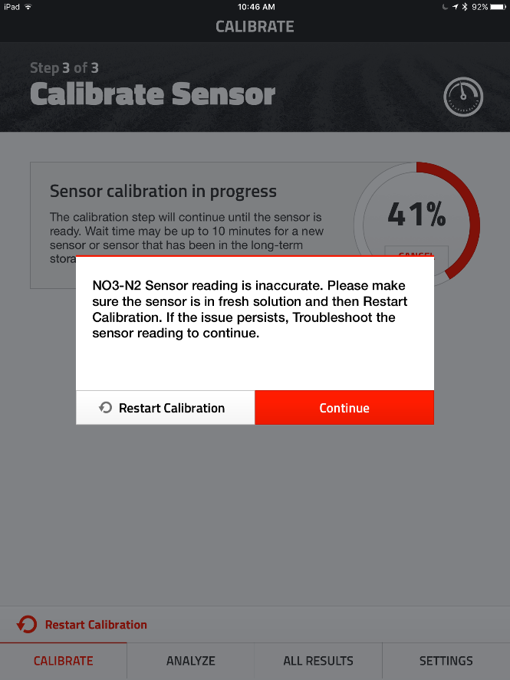
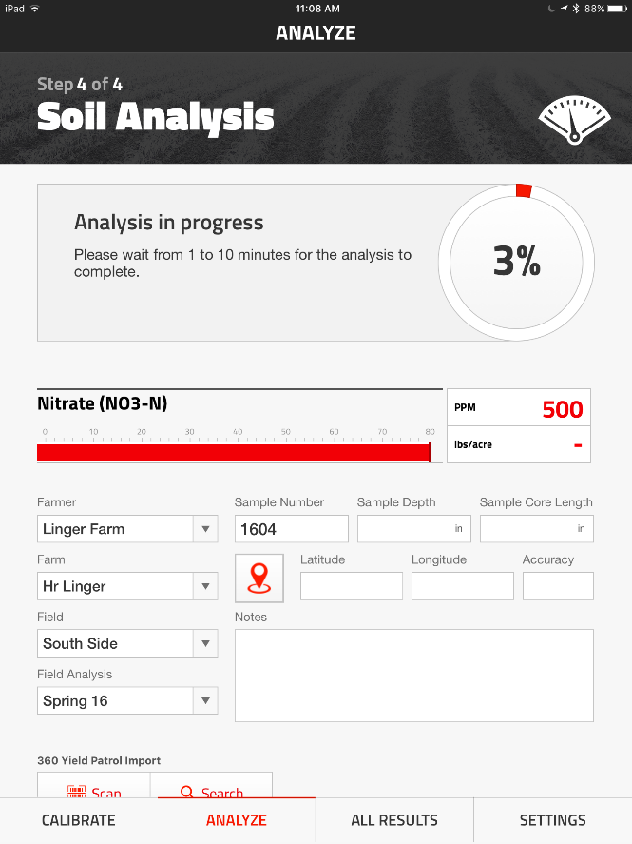
Sensor issue awareness
Error Message
Extremely high readings

Slide 5
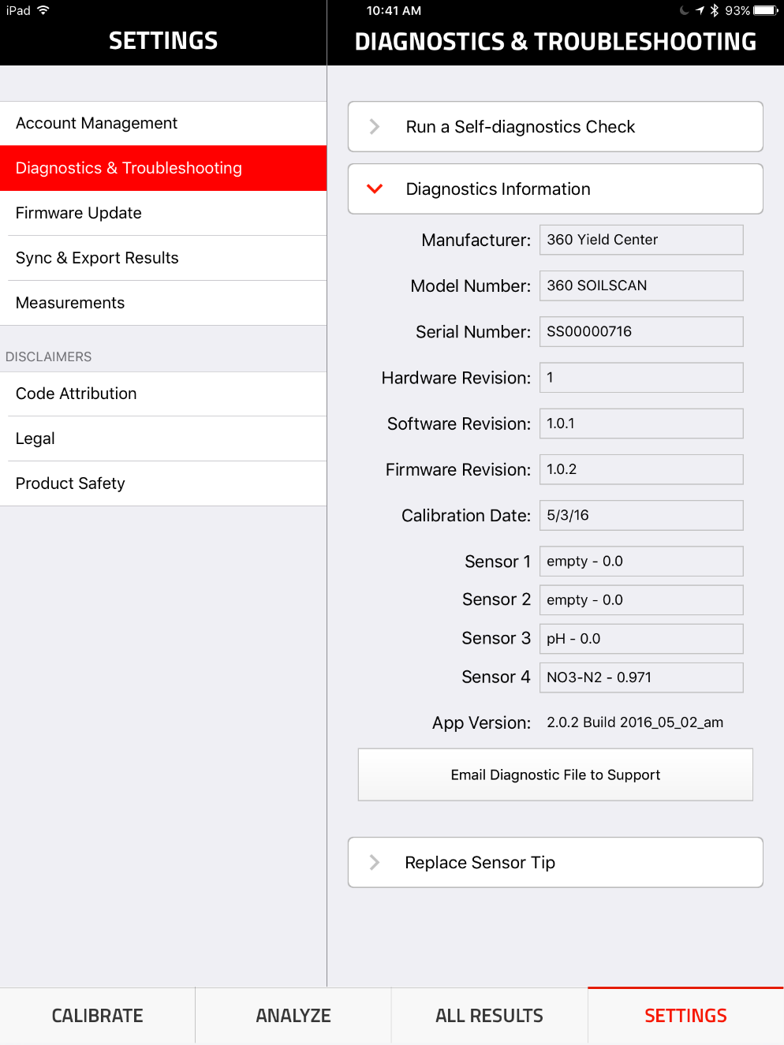
Sensor issue awareness
Diagnostics page

Slide 6
Sensor storage
Short-term Storage
Long-term Storage
nitrate sensor (gray) stores dry
reference electrode (red) stores wet
pH sensor (black) stores wet
Store in mild environment (60-80F)
Treat similar to your iPad

