Slide 1
Dealer On-Boarding Webinar – Part 2
support@360yieldcenter.com
888 512 4890

Slide 2
Administrative activities

Slide 3
360 Yield center Dealer on-boarding process
Submit paperwork
Complete dealer on-boarding call
Review Dealer Business Plan with RAM/Manager
Complete sale call ride along

Slide 4
Topic #1. Dealer Resources
Dealer Portal
Storage location for articles, marketing materials, forms, technical bulletins, and important links.
Dealer Store
E-commerce site for placing product orders.

Slide 5
Dealer Portal Access from the 360yieldcenter.com webpage via Dealer Login

Slide 6
Enter Dealer Portal Password
360DealerAccess

Slide 7
Navigate through the Portal using menu

Slide 8
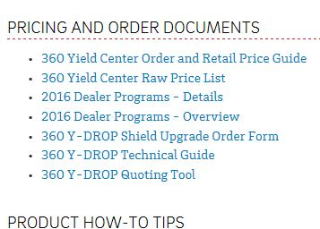
Important Ordering/Pricing Tools
Dealer Order & Retail Price Guide
360 Y-DROP Technical Guide
Excel Quoting Tool
1. Under Stores & Forms section of portal
2. Scroll down to

Slide 9
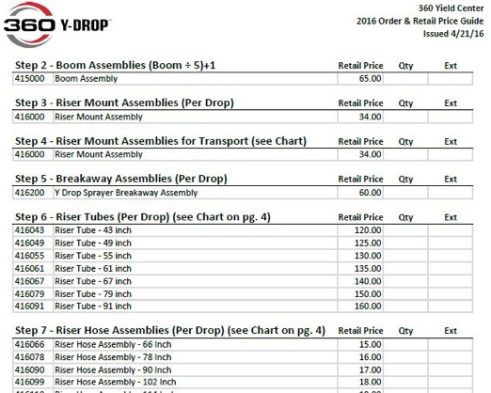
Order & Retail Price Guide
Provides Part Numbers, Descriptions and Retail Prices for our products. The Guide breaks the ordering of 360 Y-DROP system down into steps. Some steps allow for a choice between various components depending on the specifics of the sprayer that the system will be mounted onto.

Slide 10
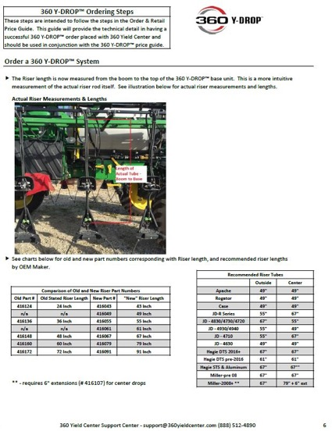
Technical Guide
Provides more technical details for the components of a 360 Y-DROP system.

Slide 11
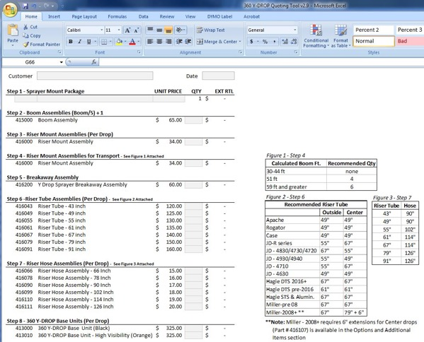
Excel Quoting Tool for Creating Retail Quotes
Follows the steps that are outlined in the order guide and technical guide.

Slide 12
Quoting Tool

Slide 13
Quoting Tool - SMP

Slide 15
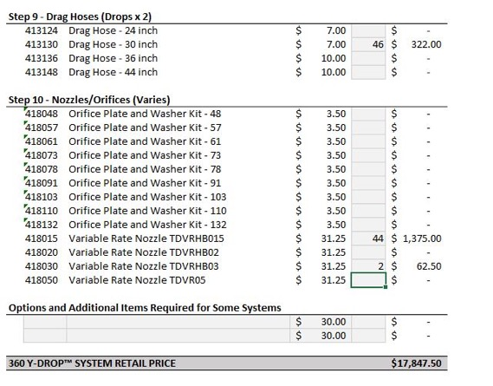
Excel Quoting Tool
The quoting tool should be used in conjunction with the order guide as a mathematical aid to assist in quoting customer’s orders.

Slide 16
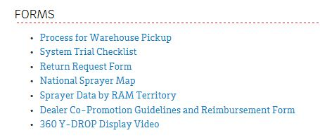
Forms Section
Forms section includes Return Request Form (to be covered later).
Co-Promotions reimbursement form.

Slide 17
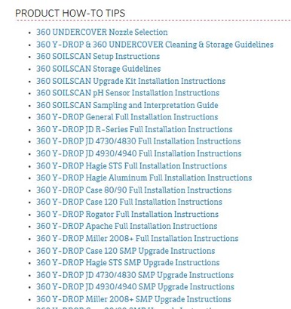
Installation Instructions
Are located under Stores & Forms = > Product How-To Tips

Slide 18
Videos and Training
Training and informational videos available as well.
Variety of topics covered.

Slide 19
Videos and Training – Y-Drop Orders
For a detailed walkthrough of the Y-drop order process, go to Videos=> Dealer Webinars=> November 10, 2015 Dealer Webinar

Slide 20
Step by Step ordering process
Fast forward to 20:50 of the webinar to walk through each step of the Y-drop ordering process.

Slide 21
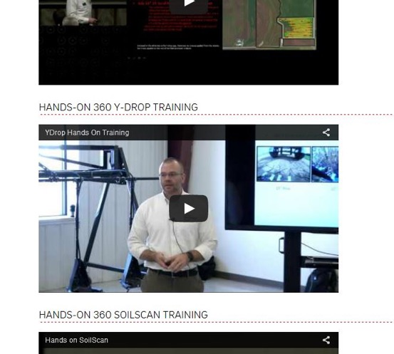
Additional Y-drop training
Training=> Hands-On 360 Y-DROP Training

Slide 22
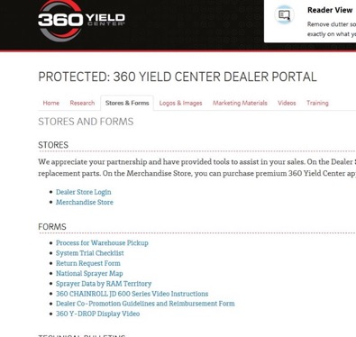
Dealer Store
https://dealerstore.360yieldcenter.com/
Access this directly via the address or through the link in the dealer portal

Slide 23
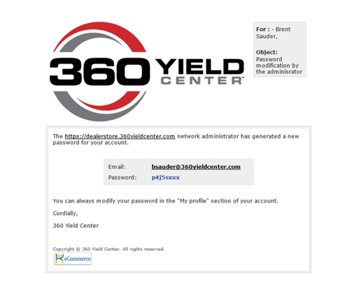
Topic #2 – Webstore Tour
You should have received an email with a temporary password to get you in the store and a PowerPoint that walks through the store.
Your password email should look like this:

Slide 24
Logging In
You have received a PowerPoint that walks through getting logged in.
If you are still having trouble with this, call Support 888-512-4890 or Brent 309-641-0578.

Slide 25
Adding Items to Cart
To order product, you must add items to your Cart (much like Amazon or other e-commerce platforms).
You can do this either through the Catalog Tree or through the Quick Order.
Pricing that you see on the store is at your Dealer Discounted Price. Your Cart total and order total will be your discounted price, not retail.

Slide 26
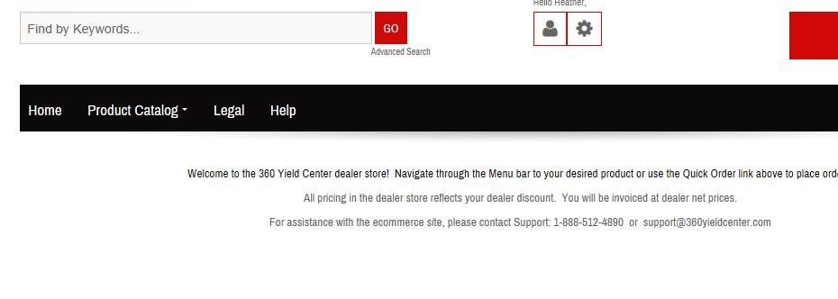
Catalog Tree
Mimics the steps of the Ordering Process. Starts with Sprayer Mount Packages and works its way down:

Slide 36
For smaller items – Parcel options will be available

Slide 38
Quick Order Option

Slide 39
Quick Order

Slide 40
Enter part #’s in Code Field. Tab through Fields

Slide 41
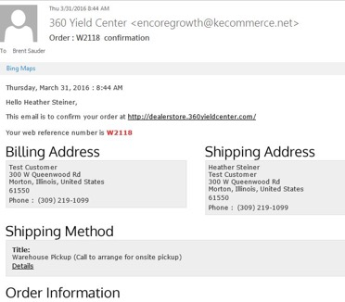
Topic #3 Shipping/Invoicing
When the order is placed, you will receive an email confirmation.
This is not an invoice, just an order confirmation:

Slide 42
Invoices are generated after orders ship
Orders generally ship within a couple days.
Your invoice will be emailed to you the day after your order ships.
You will see your tracking number for the order at the bottom of the invoice.
Cash discounts if paid in ten days (when applicable) calculate from invoice date, not order date.

Slide 43
Invoice Format

Slide 44
Invoice – Details at Bottom
Tracking Number is shown.
Also any applicable cash discount and due date for cash discount.

Slide 45
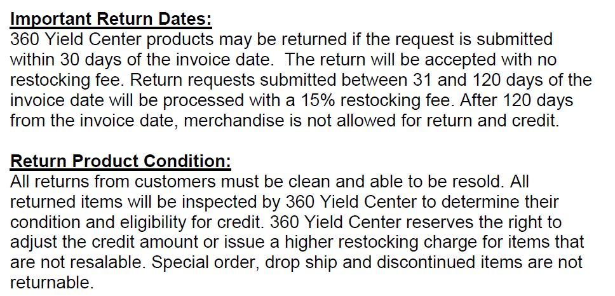
Topic #4 – Warranty and Returns
Our Return Policy is outlined in our Dealer Agreement.

Slide 46
Warranty
One Year Warranty – excluding normal wear and tear.
Excludes Third Party Components.

Slide 47
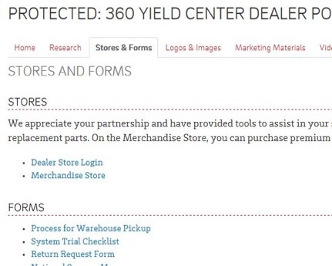
Initiating the Return Process
Return Authorization Request form is available on the Dealer Portal.

Slide 48
Complete the form and return

Slide 49
Returns
Once you have sent your Return Request to Support, we will respond back with an RTN document to include in your return shipment back to us.
The RTN document ensures that your account will be properly credited for returns.

Slide 50
Warranty Returns
For returns of warrantied items, we generally want the warrantied item returned for inspection.
We will send you replacement parts when we are notified of the issue. Your account will be billed for these items until we receive the warrantied items back from you. At that time your account will be credited.

Slide 51
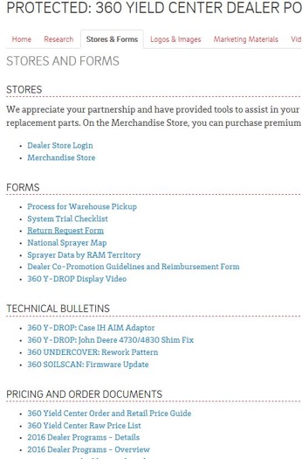
Topic #5 Programs
Program Details and an Overview are available on the Portal. Refer to these documents for details.

Slide 52
Cash Discount and Volume Incentive Program

Slide 53
Early Order

Slide 54
360 Yield center yearly calendar
Month | Activity
January | Host a customer meeting
February | Dealer Training, Regional Agronomy meetings
March
April | 360 SOILSCAN, 360 Y-DROP Sidedress
May | 360 SOILSCAN, 360 Y-DROP Sidedress, 360 Y-DROP
June | 360 SOILSCAN, 360 Y-DROP Sidedress, 360 Y-DROP, 360 UNDERCOVER
July | 360 SOILSCAN, 360 Y-DROP Sidedress, 360 Y-DROP, 360 UNDERCOVER
August | Proving Grounds – bring a group of customers! FPS
September | 360 CHAINROLL, 360 BULLET
October | 360 CHAINROLL, 360 EQUIFLOW, 360 BULLET,
November | 360 CHAINROLL, 360 EQUIFLOW, 360 BULLET
December | Host a customer meeting

Slide 55
Contact information
Support Team
888-512-4890
support@360yieldcenter.com
Accounting Team
309-938-4884
accounting@360yieldcenter.com
Marketing Team
Kelsey Seggerman
kseggerman@360yieldcenter.com

