Slide 1
Early spring diseases in wheat and sorghum webinar
May 5, 2016

Slide 2
Today’s agenda
Wheat disease and control
  Head Scab
  Powdery Mildew
  Striped Rust
  Septoria leaf blotch and stagonospora leaf/glume blotch
Grain Sorghum insect control
  Sugar Cane Aphid

Slide 3
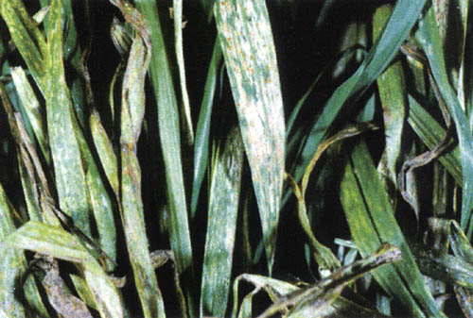
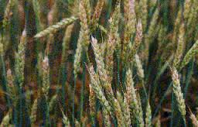
Wheat diseases
Powdery Mildew
Head Scab

Slide 4
Conditions favor disease development
Head Scab (Fusarium Graninearium)
Same organism for Giberella Stalk Rot in corn
Infections occur during flowering (Feekes 10.5.1)
Rainy, warm humid weather
Produces a mycotoxin called D.O.N.
Predictive model link: http://www.wheatscab.psu.edu/
Text alert sign up: http://scabusa.org/fhb_alert.php.
Powdery Mildew
Cool wet conditions and dense canopies 50 – 70 degrees but declines above 75 degrees
Heavy nitrogen and rapid growth in conjunction with high humidity
Need to protect the flag leaf and top of canopy
Wait to treat, not at tillering. Can help with both PM and HS

Slide 5
Wheat disease treatment
Treatment of Head Scab
  Best time is within a few days ahead of head emergence
  How to stage Wheat timing: https://www.extension.purdue.edu/extmedia/ID/ID-422.pdf
  Strobilurin products not labeled
  BASF’s Caramba Fungicide
  Consider 360 Undercover to improve coverage all around the head
Treatment of Powdery Mildew
  Good varietal resistance exists
  Do not treat too early
  Feekes 10.5 can combine treatment of Head Scan and kill two birds with one stone
  BASF’s Caramba an excellent option
  Consider 360 Undercover; drag right above the canopy to improve coverage and penetration
  Protect the flag leaf

Slide 6
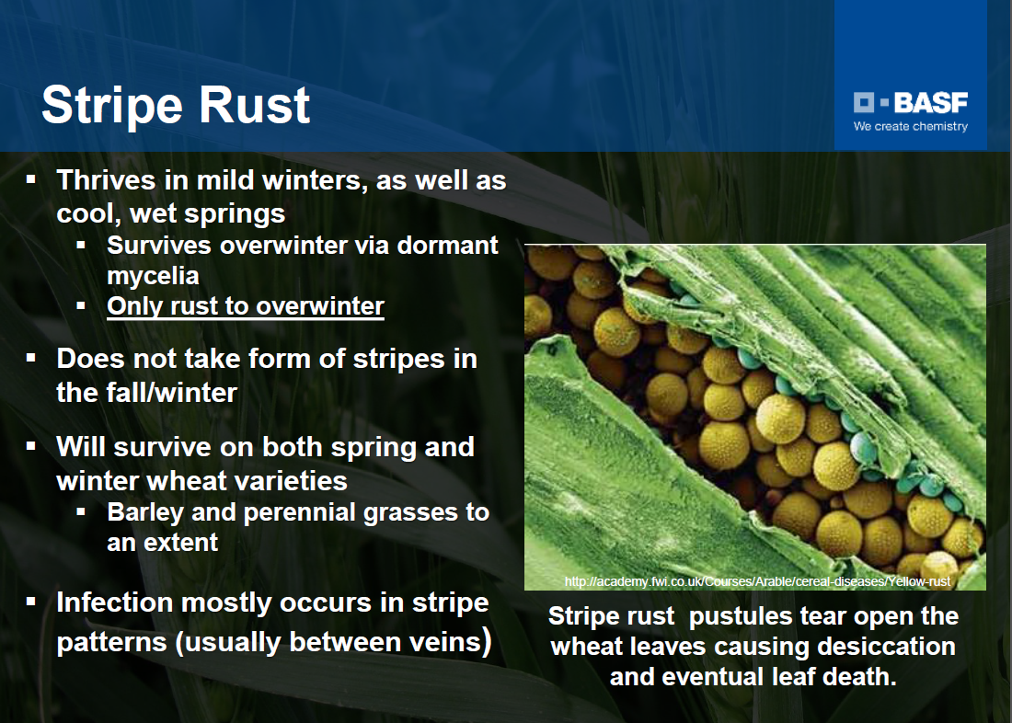
Stripe Rust

Slide 7
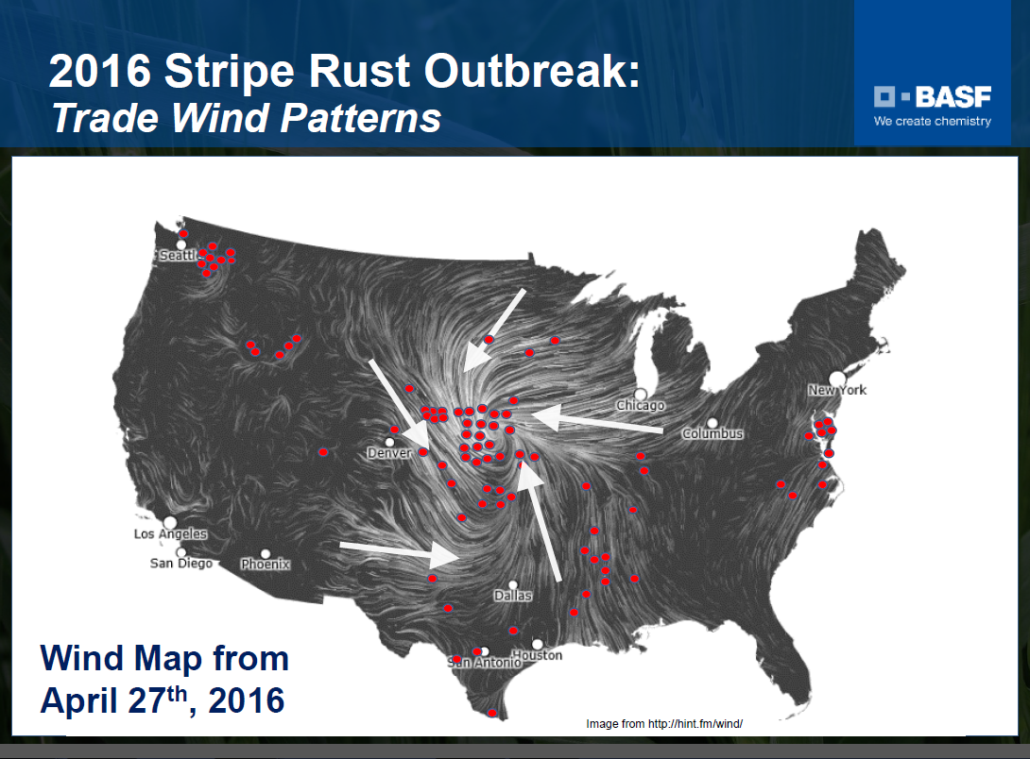
Stripe Rust

Slide 8
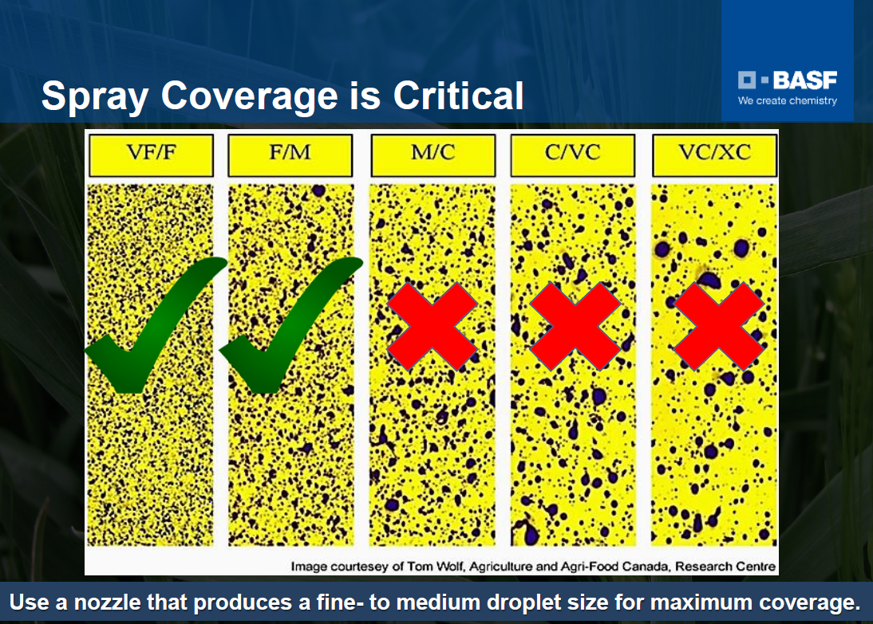
Stripe Rust

Slide 9
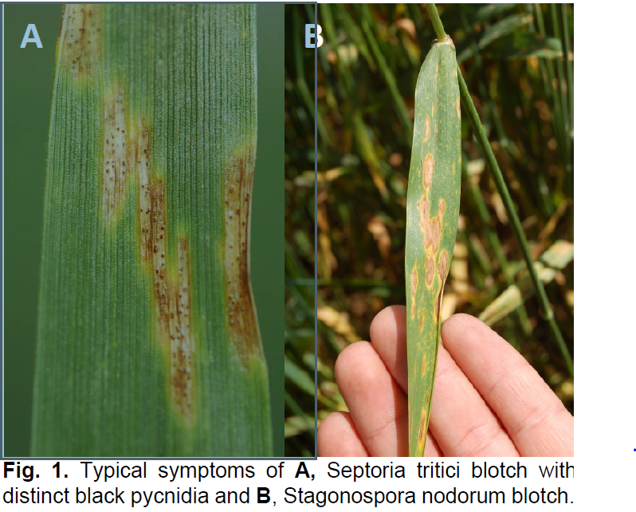
Septoria and Stagonospora

Slide 10
Septoria tritici blotch
Favored by cool wet conditions
Begins on lower leaves
Spread slows as temperatures increase
Can lead to significant yield reductions
Stagonospora nodum blotch
Can be a leaf and/or glume infection
Typically infections begin within 2-3 weeks of head emergence
Infections usually first spotted on top few leaves
Favored by wet/windy weather
Dry periods slow the development

Slide 11
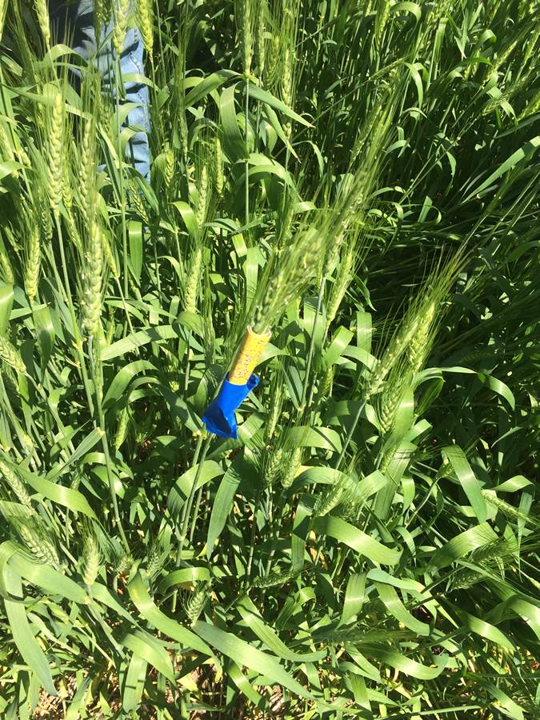
360 Undercover Wheat application trial

Slide 12
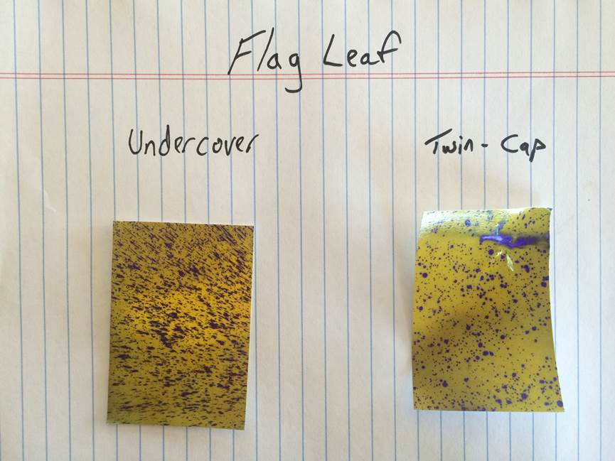
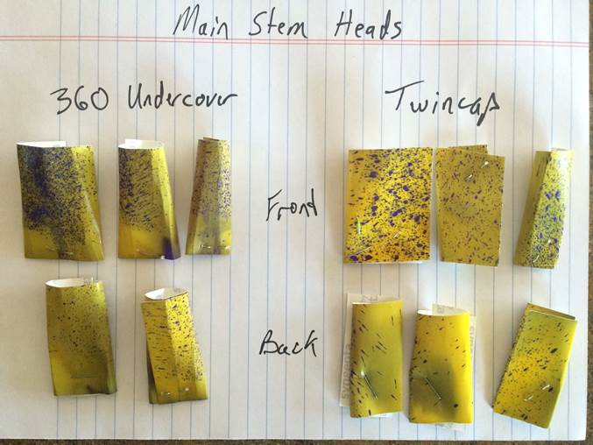

Main Stem Heads
Flag Leaf
Twin Cap
360 Undercover
Twin Cap
FRONT
BACK

Slide 13
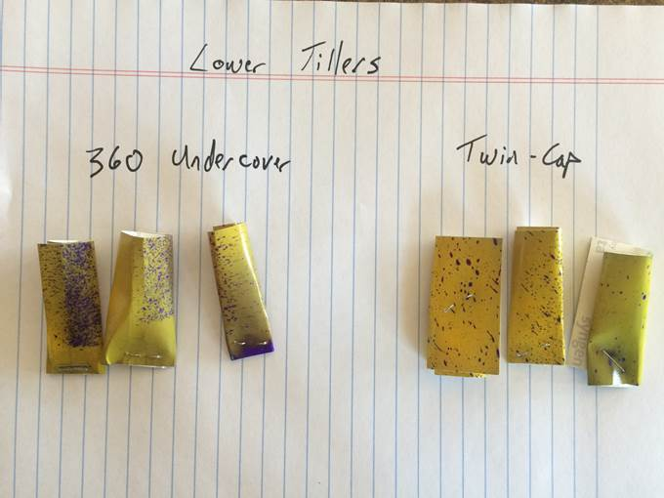
Lower Tillers
360 Undercover
Twin Cap

Slide 14
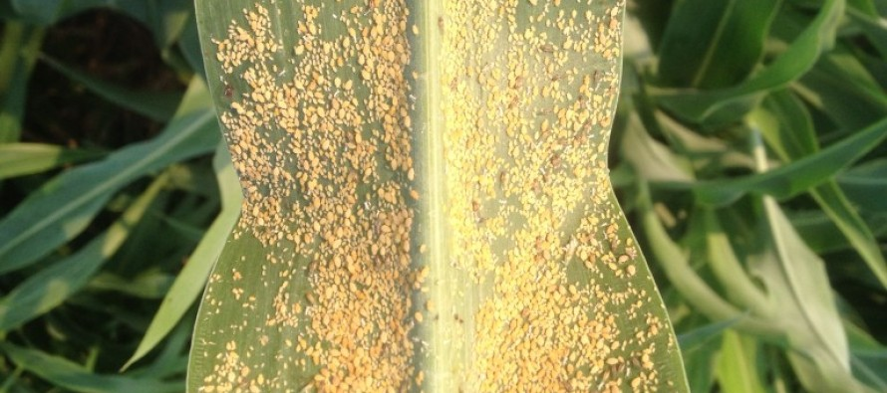
SugarCane Aphid in Grain Sorghum
Photo courtesy of Mississippi-crops.com

Slide 15
Sugarcane Aphids (Melanaphis sacchari)
Mild winter could mean another big year for SA
Two main reasons for the increase:
  Very few natural predators, takes time for the predator populations to build up
  Very high reproductive rate, explosive growth
Can cause severe yield reduction, honeydew/mold growth can reduce photosynthesis
Heavy Honeydew can actually create harvest problems
Here are a couple of great extension resource links:
University of Arkansas
Texas A&M

Slide 16
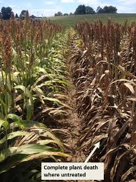
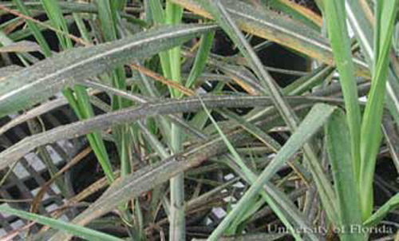
Sugarcane aphid damage
Sooty mold grows on the honeydew interfering with photosynthesis
Photo courtesy of Mississippi-crops.com

Slide 17
Sugarcane aphid
A few tips:
Scout frequently as populations can grow rapidly
Understand treatment options as some products are not as effective as others and the use of some products may require exemptions
Continue to scout up to harvest as the honeydew they produce can cause harvest issues
Coverage is key to control. Populations build on the underneath side of the leaf and it is important to get thorough coverage on top and bottom of the leaf

Slide 18
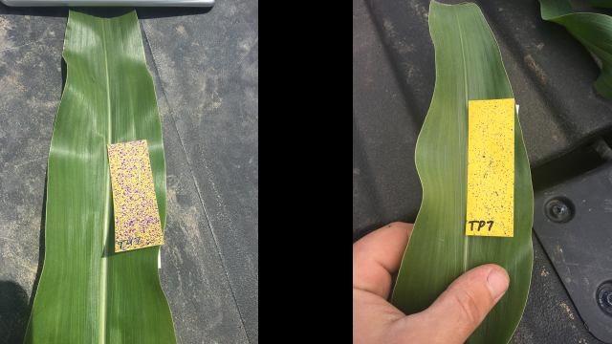
Sugarcane aphid
In the photo above we compared coverage on the top of leaf #7 between a Plane (right photo) and 360 Undercover (left Photo)

Slide 19
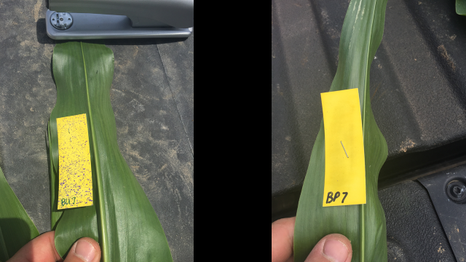
Sugarcane aphid
In the photo above we compared the coverage on the bottom of leaf #7 between an airplane (right photo) and 360 Undercover (left photo)

Slide 20
360 Undercover
I would really prefer not to spray 60’ when I can spray 120’
What’s the best way to address that concern?

