Slide 1
Nozzle selection
Ron Lloyd, 360 Yield center

Slide 2
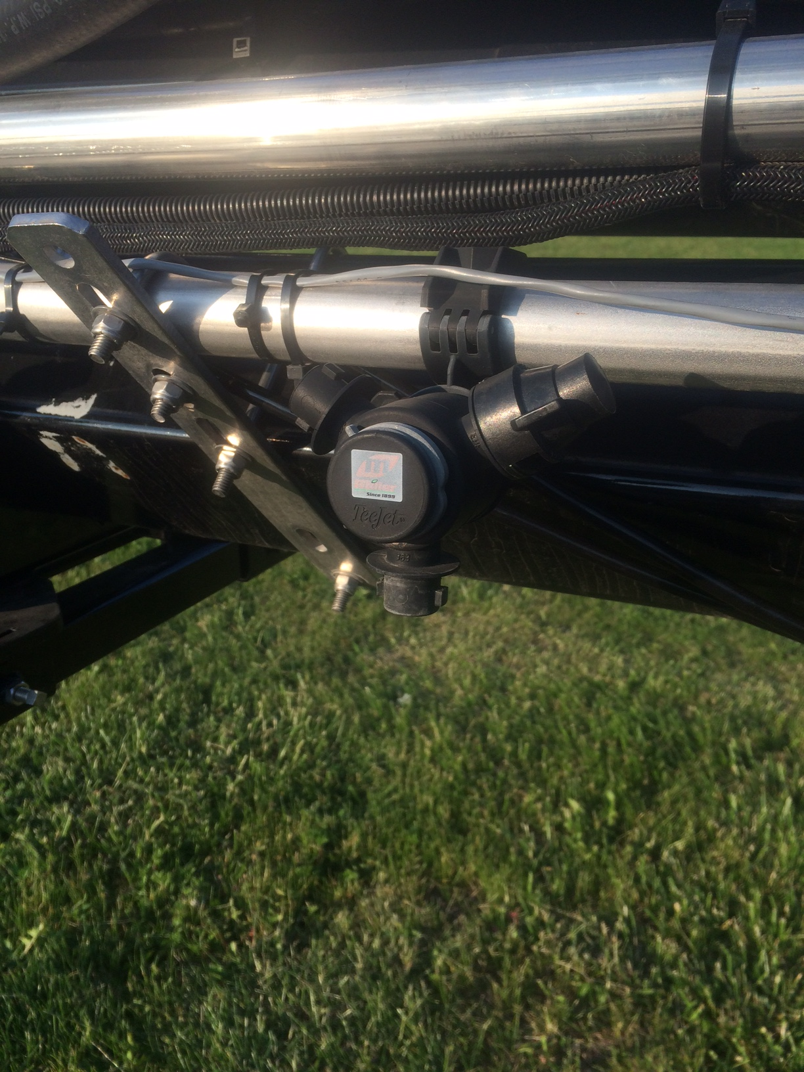
Nozzle selector

Slide 3
Goal of application
Effectiveness:
Placement
On target (no drift)
Specific portions of plant (crop or weed)
Coverage
Even coverage or concentration
Timing

Slide 4
Goal of application
What do we control (decisions we make)
What, when and how we spray
Product and rate
Timing
Appropriate stage size of target (crop/weed/disease/insect)
Wind speed and direction (choosing when this is appropriate)
Gallonage of solution sprayed (GPA)
Ground speed
Boom height
Droplet size & pressure (through nozzle selection)

Slide 5
After you selected the “right” product
READ THE LABEL
Many labels will give guidance on:
Minimum GPA or range of acceptable volumes
Wind speed and possibly ground speed
Droplet size preference or lean towards larger droplets for drift management
You should balance drift management with adequate coverage of target
There are generally two categories in herbicides, fungicides and insecticides: Contact and Systemic
Contacts rely on thorough coverage of the plant material (smaller droplets)
Systemics also need good coverage but also rely on concentration of the solution (larger droplets)

Slide 6
Broadcast nozzle selection guide
Information taken from TeeJet® TECHNOLOGIES Catalog 51A p.4

Slide 7
Droplet categories
Fine (F)
Medium (M)
Coarse (C)
Very coarse (VC)
Extra coarse (XC)
Ultra coarse (UC)

Slide 8
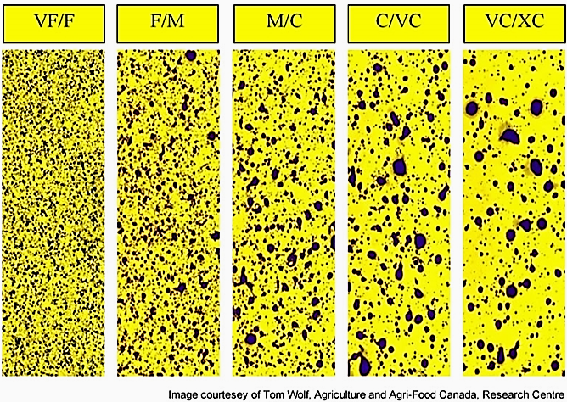
Spray coverage is critical
Slide from recent BASF e-blast regarding Stripe Rust in wheat

Slide 9
360 undercover
We have changed the paradigm a bit with this technology
Using more nozzles
Applying in the canopy vs. over the top
We have seen in our data and research that it can increase effectiveness (we believe due to coverage and placement)

Slide 10
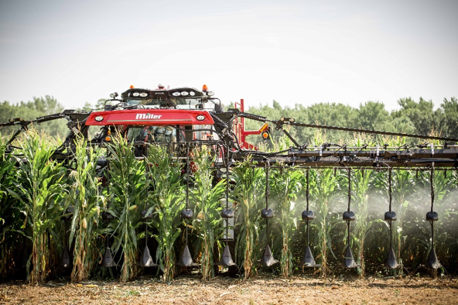

Slide 11
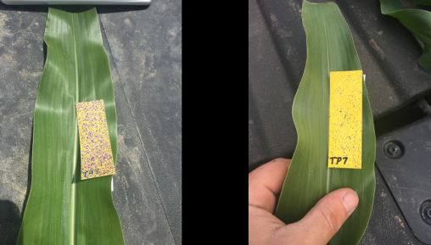
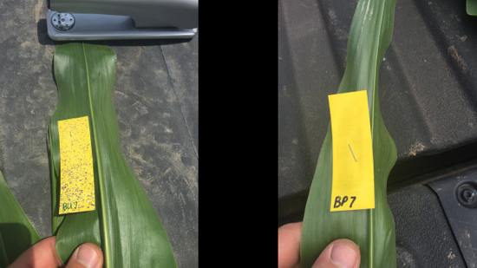
Comparison of coverage on the top of leaf #7 between a plane (right photo) and 360 UNDERCOVER (left photo)
Comparison of coverage on the bottom of leaf #7 between a plane (right photo) and 360 UNDERCOVER (left photo)

Slide 12
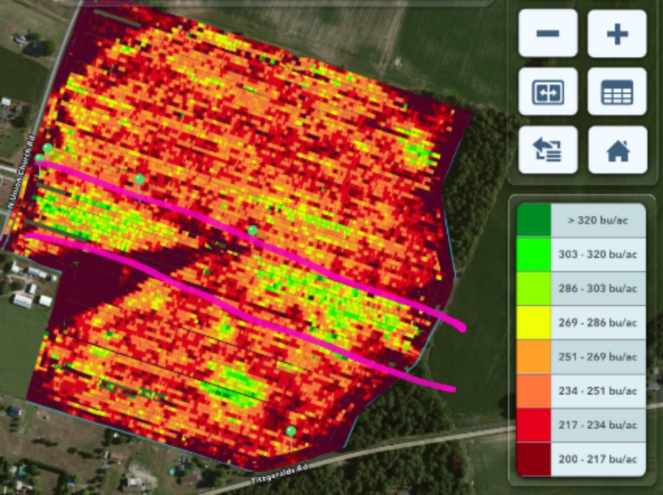
Headline AMP applied via airplane @ 3 GPA
Headline AMP applied via UNDERCOVER @ 12 GPA

Slide 13
360 UNDERCOVER
What decisions does this change?
The primary difference is our nozzle selection. Generally will have smaller nozzle size (orifice) because more of them than in over the top application

Slide 14
Let’s pick a scenario and pick our nozzles
Spraying a fungicide
Volume: 15 GPA
Ground speed: 9mph
Nozzle: TURBO TEEJET®
Row spacing: 30”
Number of nozzles per row (in each 360 UNDERCOVER unit): 3

Slide 15
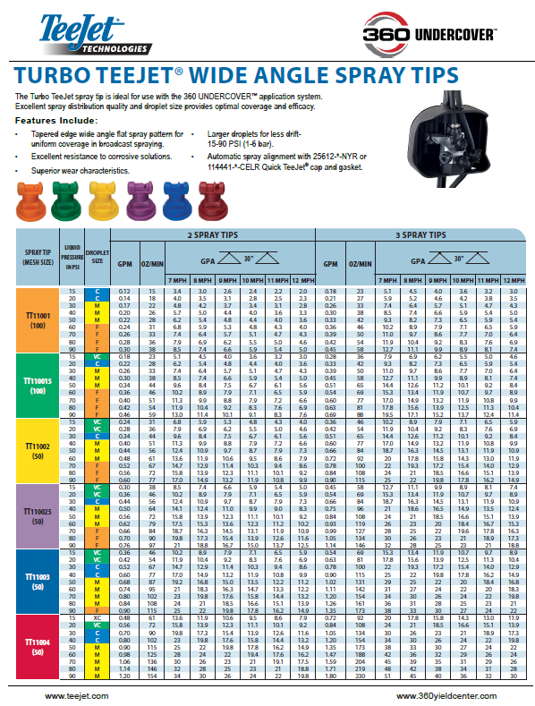
Information from Nozzle Selection For Complete Under-Canopy Coverage (360 UNDERCOVER) from 360 Yield Center p. 2

Slide 16
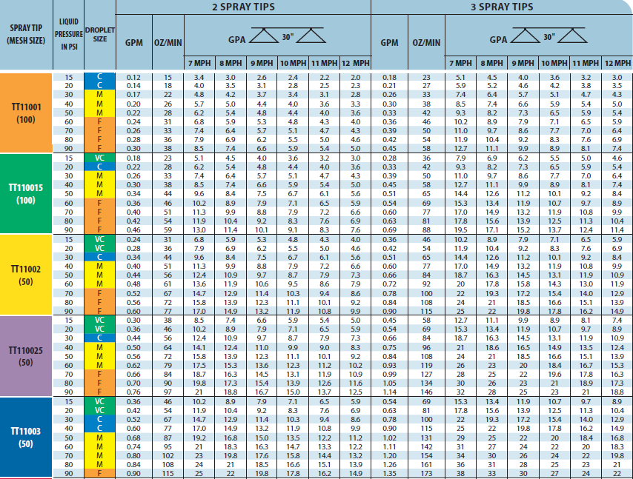
Refer to the 360 UNDERcover nozzle guide
Information from Nozzle Selection For Complete Under-Canopy Coverage (360 UNDERCOVER) from 360 Yield Center p. 2

Slide 17
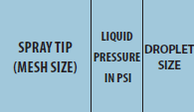
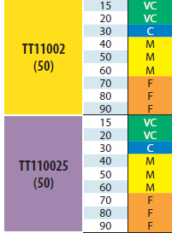
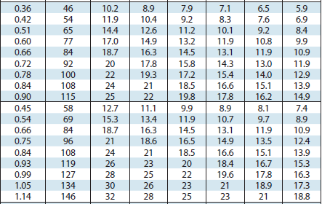
Refer to the 360 undercover nozzle guide
Turbo Teejet ® Nozzle
Information from Nozzle Selection For Complete Under-Canopy Coverage (360 UNDERCOVER) from 360 Yield Center p. 2

Slide 18
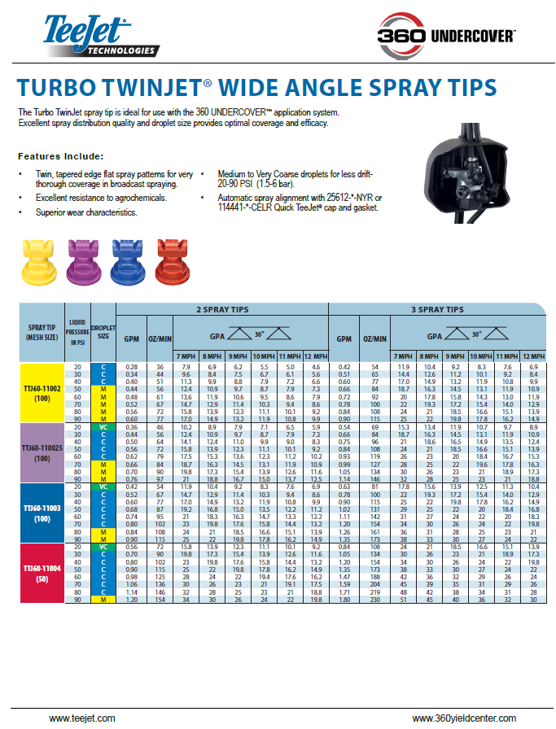

Slide 19
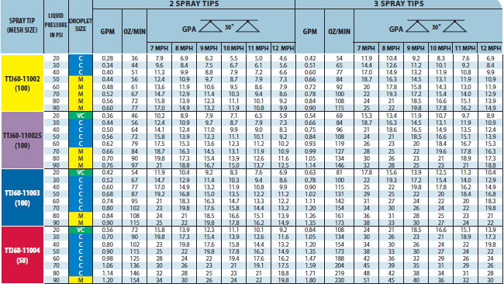
TURBO TWINJET® nozzle page 3 from 360 UNDERCOVER nozzle guide

Slide 20
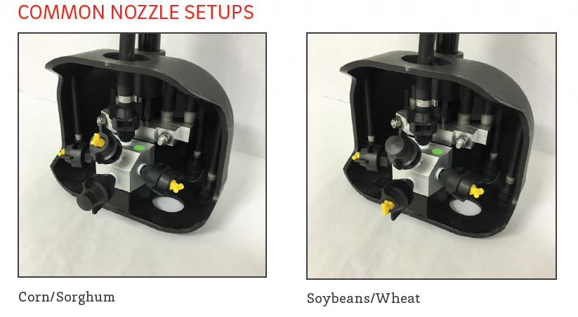
Nozzle opening options
Some will run nozzles from boom (particularly for taller or larger crop timings

Slide 21
Nozzle orientation

Slide 22
Thank you Questions?

