Slide 1
360 Soil Scan

Slide 2
Overview
How should I sample?
  Where
  When
  How
How do I interpret the results?
What about pH?

Slide 3
1) How should I sample for nitrates
Where should I sample?
  How was the N applied
  How do I plan to apply my N
When do I sample?
How do I sample?
  What depth
  How many probes per sample
  How do I handle the sample

Slide 4
2) How do I interpret the results
Definitely art AND science involved
Understand the conversion process
Estimate the amount of both NH4+ and NO3-
Do the results makes sense
Utilize the N calculator
Then decide:
    Am I on track
    Have a incurred losses
    Yellow light

Slide 5
Where should I sample
Remember that this is a decision process
Consistency and accuracy are critical- sampling is the hard part
Much more error from sampling procedure than measurement
Do you plan to VR or flat rate
  VR would require higher fidelity of data so more samples

Slide 6
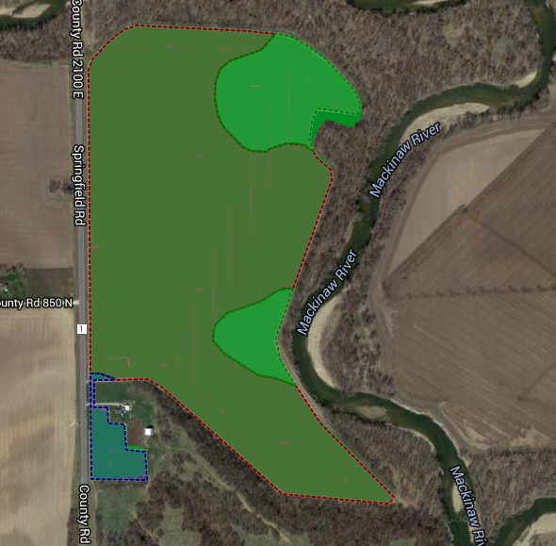
Where do I sample
Single Rate
Variable Rate

Slide 7
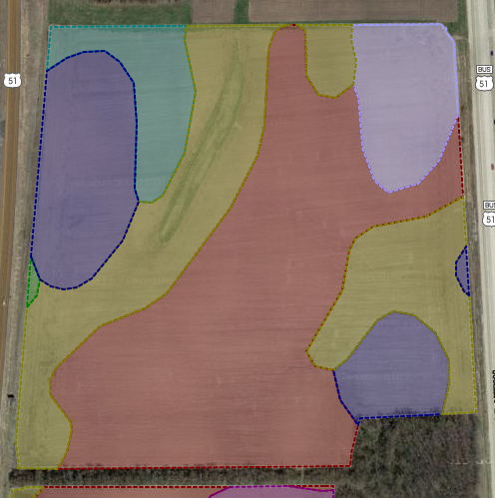
Where do I sample
Single Rate
Variable Rate

Slide 8
Where do I sample
How was your N applied
    Banded
      Requires more intense sampling across the row
      Use sampling board for consistency
    Broadcast
      Since N distribution is more uniform (in theory), sampling across the row can be less intense
      Still want a complete picture of the profile

Slide 9
Where do I sample
Iowa soybean Association study

Slide 10
Nitrate movement 2015
12” sample depth, Four weeks following application

Slide 11
Where do I sample
If the results make sense you likely have enough samples to make a decision
If after interpreting the results they don’t seem to make sense, we would recommend additional sampling to gain clarity

Slide 12
When do I sample
One of the big benefits of your 360 SOILSCAN machine is that it allows you to make immediate decisions
    The data is closest to the decision time
    Reduces the likelihood of sample variability from handling
Pull your samples as close to the time of application as possible

Slide 13
How do I sample
Remember that we are trying to learn:
  Where is my N relative to my plant roots
  What form is it currently in
  How do the results affect my plans

Slide 14
How do I sample
For the most part we would recommend a 12” sample
12” - 24” on at least some samples to understand movement
There could be some exceptions
    How long ago do you apply the N
    What form was applied
    What has the weather been like since you applied
    For example: if you applied 28% UAN solution three weeks ago and you have had ½” of rain, movement is likely minimal. This might be a good time to take a 12” sample and split it at 0-6” and 6-12” to learn about movement and conversion

Slide 15
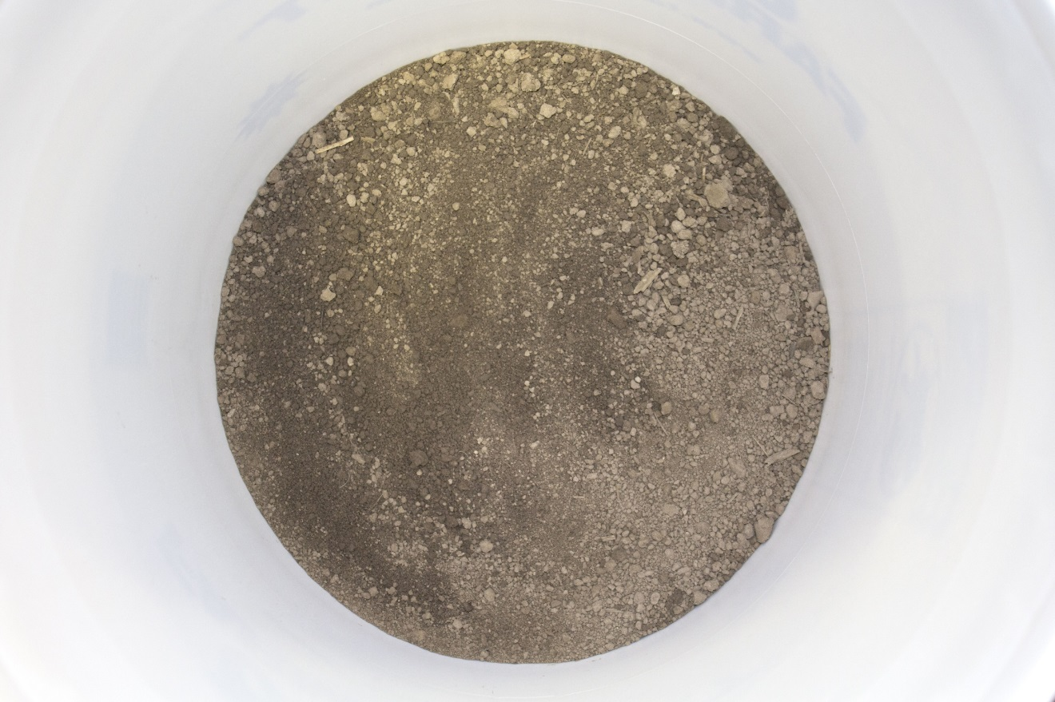
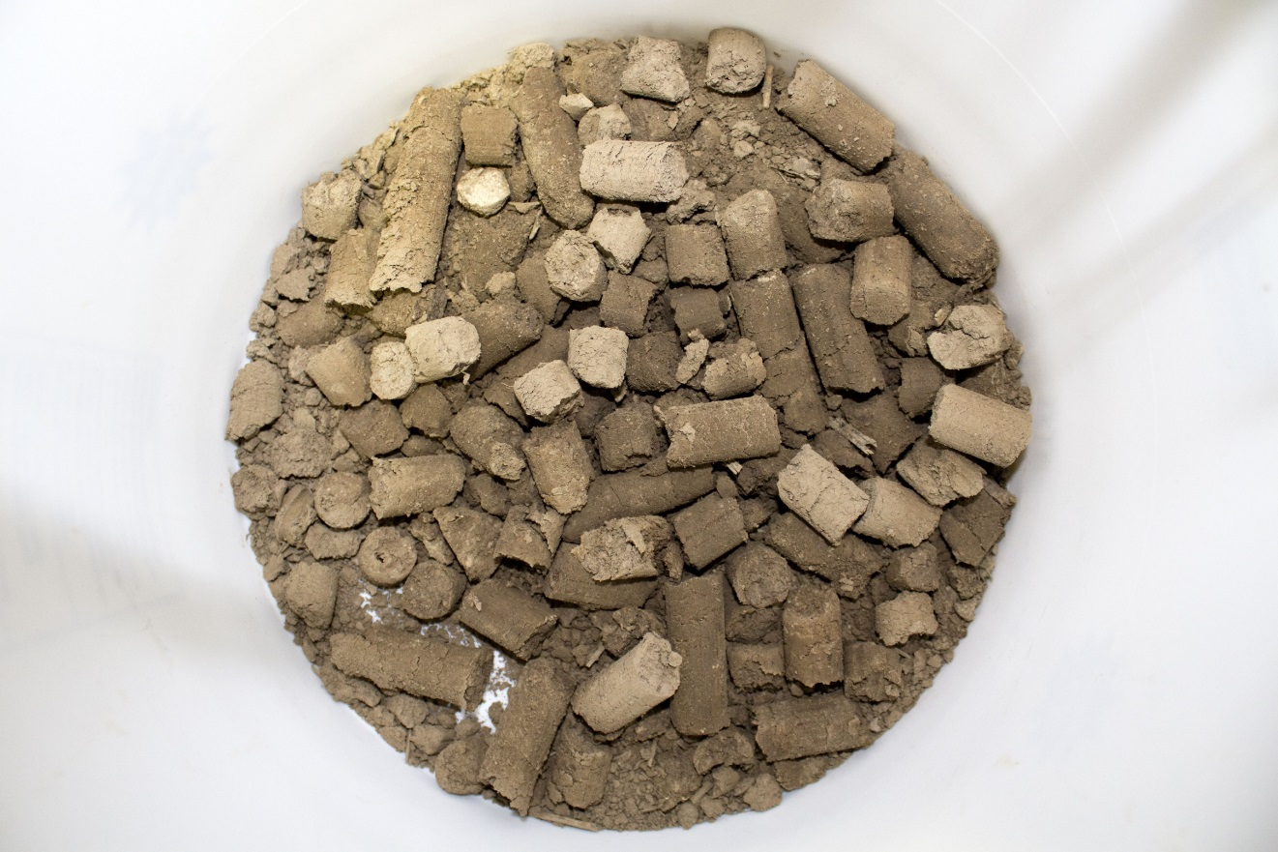
How do I handle the sample
Make sure to break up the soil as much as possible

Slide 16
How do I handle the sample
Make sure to break up the soil as much as possible
Insures thorough mixing and extraction of NO3- from the sample
Do not wait to run the samples
If you are going to wait, then get the samples on ice or in a freezer as quickly as possible

Slide 17
How do I interpret the results
This is where the art is critical to join with the science
Understand that we are testing NO3- but also need to understand how much NH4+ may be present as well
Use a local university conversion table
Understand that this is a biological process and as such things like temperature, moisture, oxygen, pH, residue etc can impact these results

Slide 18
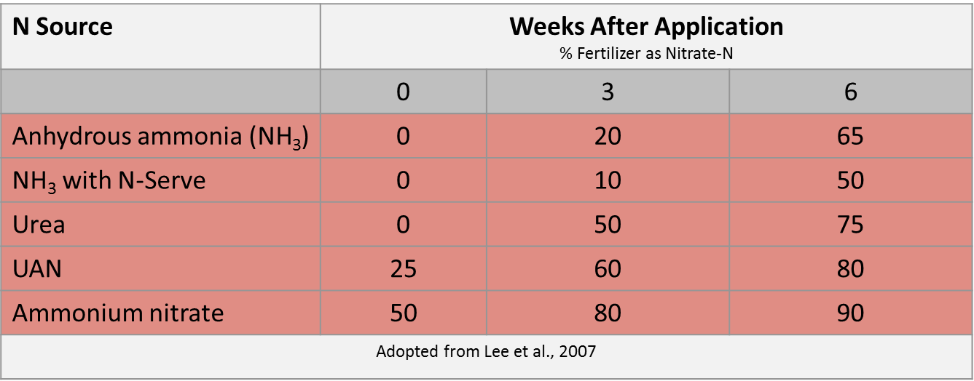
How much no3- should I see

Slide 19
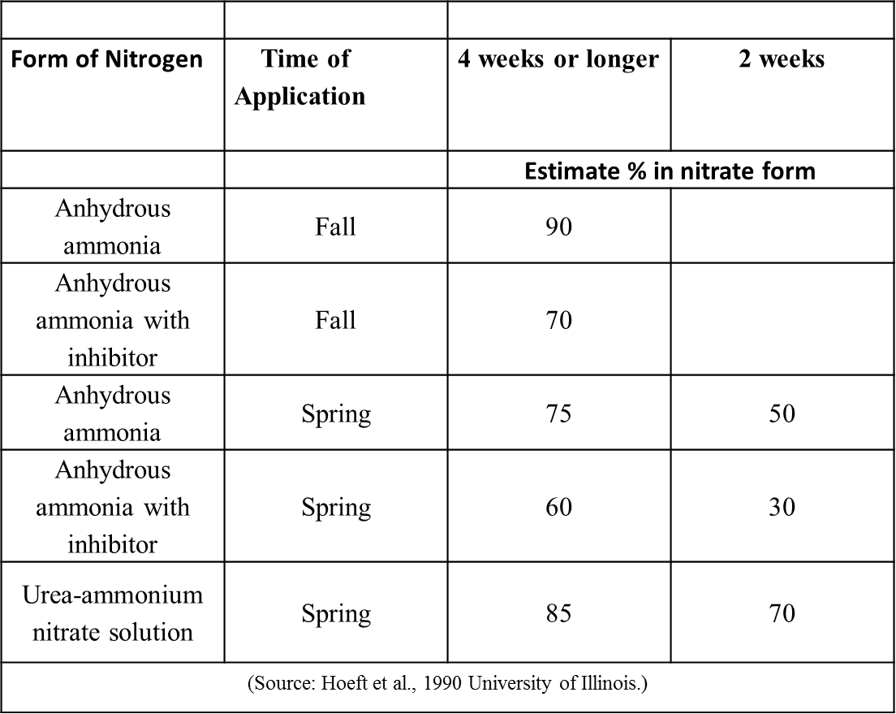
A different version

Slide 20
Lets work through an example
At planting the grower applied 20 gal of 28% via weed-n-feed worked in, corn bean rotation, 3.5 % OM prairie type soil
  Timing - about 22 days ago
  Rainfall – around 3” of rain in two separate steady rainfall events
  Temperatures – fairly normal
In this case do you believe the grower has experienced much denitrification, volatilization or leaching

Slide 21
How much no3- should I see

Slide 22
How do I interpret the results
Based on the information how much NO3- would you expect to find
  ~ 60 lbs N applied
  Likely low loss
  Should expect some mineralization ~ maybe 15 lbs +/-
Based on what I know I am going to pull a 12” sample because of the weather and rapid growth of the crop
Because it was not banded I am going to pull samples from three or four spots across the row
Based on what I know I doubt there has been excessive loss
SO: 60 lbs at 60% conversion (3 weeks) = 36 lbs of NO3- and about 24 lbs of NH4+
Plus I should find a little additional N from mineralization so I am going to figure there should be around 36 lbs of NO3- in my sample

Slide 23
How do I interpret the results
When I pull a 12” sample what number should I expect to find in this case?
A 12” sample is approximately 4 million pounds of soil. So to convert the 360 SOILSCAN reading to lbs I will multiply my ppm number by 3.6
Based on the weather, conversion etc before I pull my sample, I know I should expect a ppm number of about 10 ppm because 36 lbs
Therefore my 360 SOILSCAN reading should be somewhere around the 8-12 ppm range

Slide 24
How do I interpret the results
Let’s say you took two samples in the dark ground and two in the light ground
In the dark ground the two composite samples read 12 ppm and 14 ppm
On the light ground the two composite samples read 9 ppm and 10 ppm
Question #1): Do you believe the samples to be fairly good samples?
Question #2): what would you recommend to the grower based on what you found?
Question #3) As you run the N calculator on the 360 SOILSCAN app what should you tell the grower?

Slide 25
One more example to explore
Grower applied 120 lbs base rate of anhydrous unstabilized on April 15th
Grower added an additional 10 lbs in the starter
He planted May 1st
He is ready to apply his first sidedress application using a YDROP sidedress system at V5/V6 and today’s date is June 6th
The weather was very cold through the end of April and then a warm front came through and it has been very nice since the beginning of May
I go sample at 12” depth
I run my SOIL SCAN samples

Slide 26
Let’s walk through this example
I am going to assume that since it was pretty cold early and then warmed up that my anhydrous has converted at about 75-80%. So 120 lbs x .8 = 96 lbs total of my applied N should be in the Nitrate form
Plus I should have some mineralized plus the 10 lbs from starter so maybe 100 or so pounds but some of that has likely been taken up by the plant
Your SOILSCAN results come back and they should a reading of 14 ppm
What would you do? What do you ask this grower?

Slide 27
A different version

Slide 28
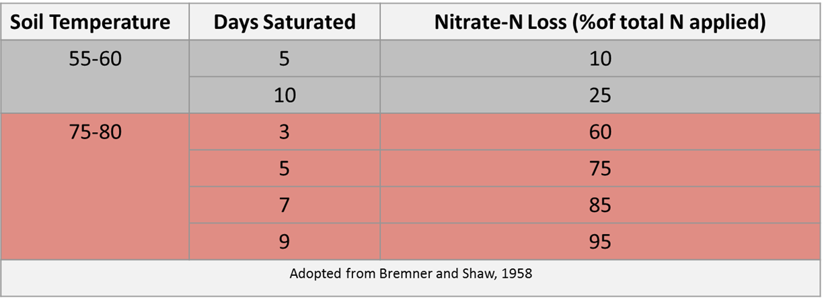
How much no3- have I lost

Slide 29
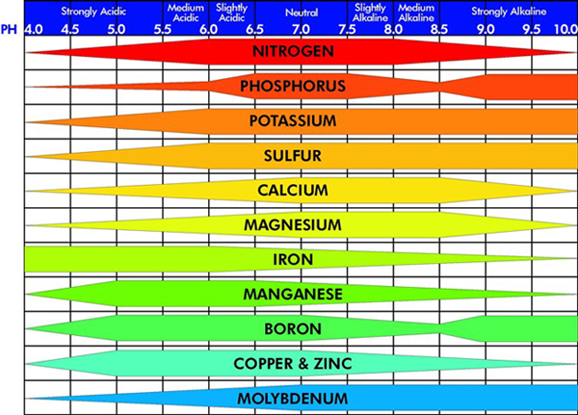
What about pH
360 SOILSCAN measures the pH of the water in your soil
Why is water pH important?
  pH helps determine the solubility of nutrients and thus their availability for plant uptake

Slide 30
Why is ph important
Important in the degradation of certain herbicides
Mineralization of Organic matter decreases as pH declines
pH imbalances dramatically impact biological and enzymatic activity in your soils
Table 2: Maximum, minimum, and optimum pH values for microbial groups. (adapted from Smith and Doran 1996)
Microorganisms | Range | Optimum
Bacteria | 5 - 9 | 7
Actinomycetes | 6.5 - 9.5 | 8
Fungi | 2 - 7 | 5
Blue green bacteria | 6 - 9 | > 7
Protozoa | 5 - 8 | > 7

Slide 31
Why is ph important
Use the pH sensor as a diagnostic tool to help understand some of the issues that could be cropping up in your field
Do you have some weedy spots?
Do you have areas in the field where the crops never seem to look right
The pH meter is a great tool to help diagnose some of these issues
Recommend a 6” sample depth in conventional till
Recommend a 0-3” and 3-6” sample in no-till

Slide 32
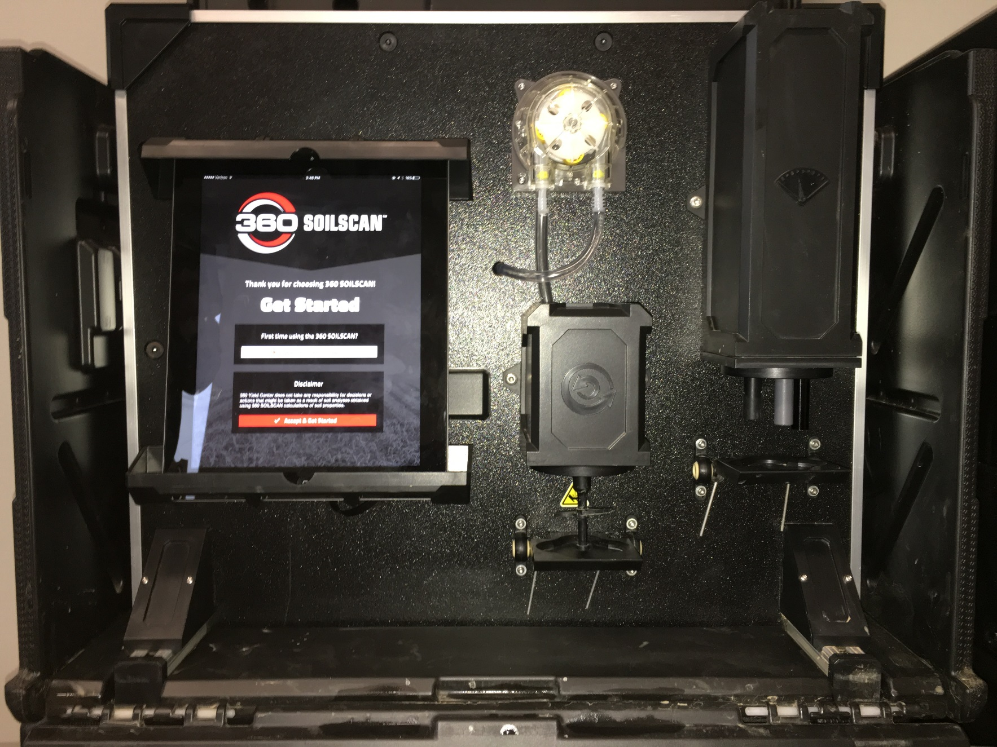
SOILSCAN Overview

