Slide 1
June 2 Dealer Webinar
36o soilscan results vs. lab

Slide 2
360 SOILSCAN vs. lab
Why are my results different from a lab?
Let’s go back and discuss N in the soil real quick

Slide 3
360 SOILSCAN vs. Lab
Nitrification
Nitrification is rapid (2-3 weeks) and is the process of converting NH3 or NH4+ to NO3-
Process is greatly reduced by: cool soils <50, low pH, and waterlogged soils
(Nitrosomonas Bacteria)
NH3 + H NH4+ NO2 + O2 NO3-
Requires oxygen and therefore will not take place in saturated soils. N def. will show in wet springs.
No oxygen required therefore this process will take place in saturated soils.

Slide 4
SOIlscan update- Does handling matter?
When there is ample ammonium in the sample we tend to see larger spreads in the results which makes perfect sense for two reasons:
Conversion in the handling process getting the sample to the lab
Conversion in the lab process of drying the sample

Slide 5
Does sample handling matter?
Sample Frozen and shipped in cooler
Sample Frozen and shipped standard
PPM | NO3- | NH4 | NO3- | NH4
160# fall NH3 | 23 | 3 | 45 | 2
160 # Spring NH3 | 25 | 7 | 45 | 6
160 # manure | 18 | 3 | 70 | 5

Slide 6
Does sample handling matter?
Sample Frozen and shipped in cooler
Sample Frozen and shipped standard
Pounds | NO3- | NH4 | NO3- | NH4
160# fall NH3 | 83 | 11 | 162 | 7
160 # Spring NH3 | 90 | 25 | 162 | 22
160 # manure | 65 | 11 | 252 | 18

Slide 7
Comparing soil handling techniques
 | NO3- | NH4 | NO3- | NH4 | NO3- | NH4
160# fall NH3 | 23 | 3 | 45 | 2 | 32 | 3
160 # Spring NH3 | 25 | 7 | 45 | 6 | 33 | 6
160 # manure | 18 | 3 | 70 | 5 | 37 | 4
Lab #1 Frozen & shipped in cooler
Lab #1 Frozen & shipped standard
Lab #2 Frozen & shipped Standard
Lab #2 is a one day ship time, lab #1 is 300 miles away so longer ship time

Slide 8
360 SOILSCAN vs. lab
Comparing the two processes
360 SOILSCAN
Pull the sample
Immediately test (not much nitrification occurring)
Use water to access and flush soil NO3-
Soil Lab
Pull the sample
Shipped and sits in the mail (many samples arrive at labs unfrozen)
Lab slowly dries the soil warming it to 104 degrees (this is done to stop nitrification) but could this slow warming actually drive some nitrification?
Chemical extraction used to pull all NO3- out of soil

Slide 9
360 SOILSCAN vs. lab
Where do we see the biggest differences?
Many times the 360 SOILSCAN machine and the labs are very similar
Would typically expect some differences
The spreads tend to be larger when samples contain more Ammonium nitrogen i.e. soon after application or in manured fields
WHY?
Think back to the processes we defined and what might be happening
If there is more N to convert then the spread would be larger
Once the majority of NH4+ is converted to NO3- the numbers are typically very close. By sidedress time, much should be converted.
Some data from our own testing

Slide 10
360 soilscan vs. lab
360 SOILSCAN- Wet vs. Dry
Remember that the wet sample is the plant’s environment at the time of sampling

Slide 11
360 soilscan vs. lab
360 SOILSCAN- Wet vs. Dry
Remember that the wet sample is the plant’s environment at the time of sampling

Slide 12
360 soilscan vs. lab
Common Questions
Question #1: Is it the testing procedure or the machine?
Question #2: What about the ALP data?
let’s think about that process:
Soil sample is dried first
Sample tested at the lab
Dried sample (no nitrification) sent to us for testing
So really it makes perfect sense

Slide 13
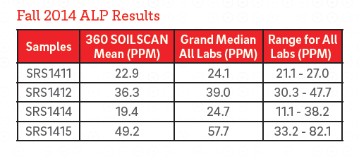
360 soilscan vs. lab
ALP Testing

Slide 14
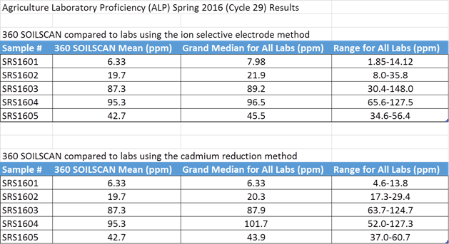
New ALP results are in

Slide 15
360 SOILSCAN vs. lab
So are we saying that 360 SOILSCAN is correct and labs are wrong?
NO! we are saying both are correct…just different

Slide 16
360 SOILSCAN vs. lab
How do I explain that to my customer?
We have thoroughly tested our system and have complete confidence in the combination of 360 SOILSCAN in combination with the nitrogen calculator app
Both ways are correct….just different

Slide 17
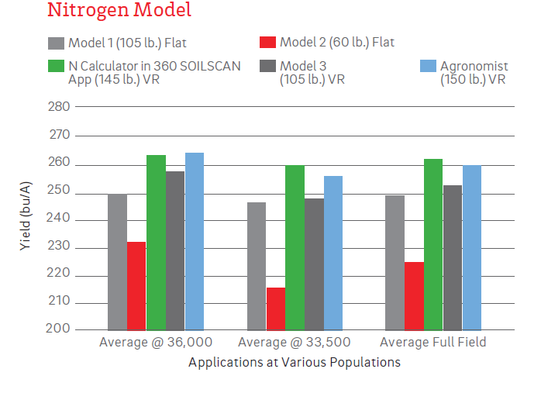
360 soilscan vs. lab
360 SOILSCAN Nitrogen Rec Trial

Slide 18
360 SOILSCAN Vs. lab
Bottom line is that we are not at all surprised when lab results differ from 360 SOILSCAN…our own data would confirm that point
This is a great tool to help ground truth nitrogen models
Neither system is wrong, just understand that we have worked with our system to develop recommendations that we are confident will work on your farm

