Slide 1
360 Undercover product training

Slide 2
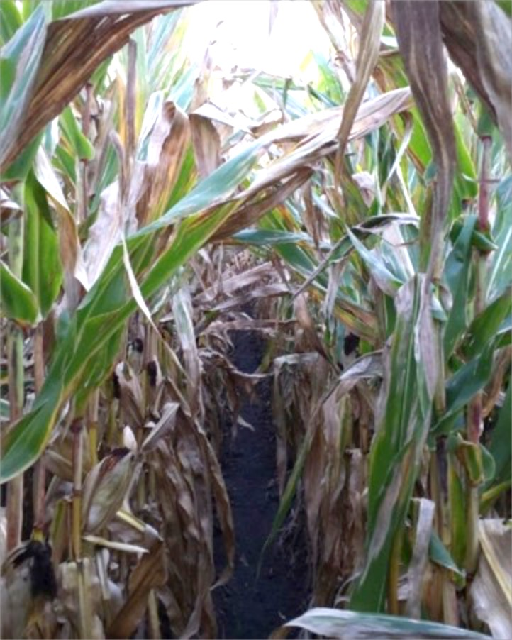
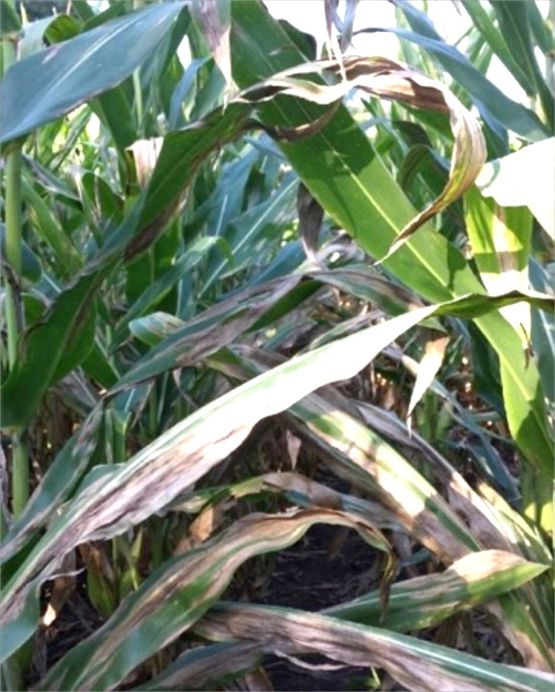
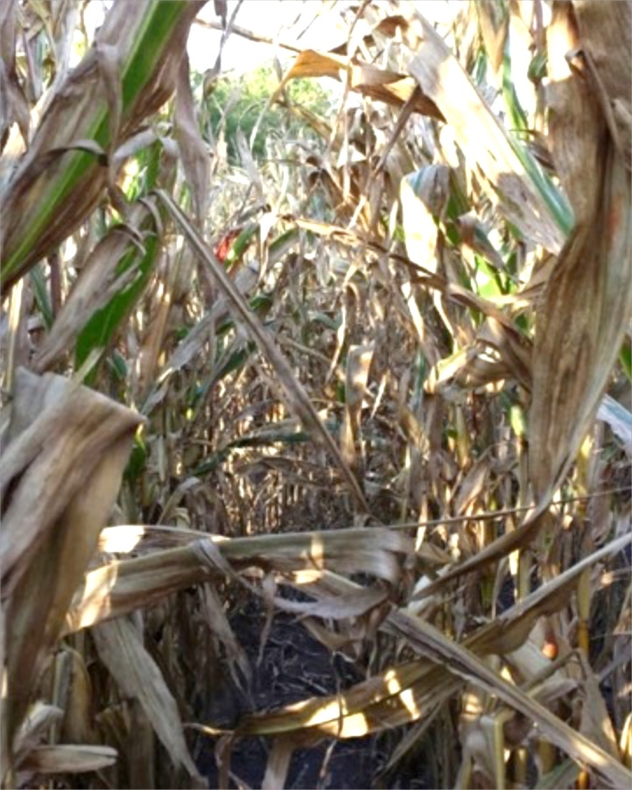
14 DAT
21 DAT
35 DAT
59 DAT
Madison Co. IA Time Lapse Primary Diseases: NCLB, Physoderma, & Common Rust
Photo courtesy Todd Hofsaess, BASF Headline AMP at 10 oz/a, applied at tassel
Untreated
Untreated
Untreated
Untreated

Slide 3
More accurate application with 360 UNDERCOVER
360 UNDERCOVER™ is a multi-directional spray applicator that delivers fungicides, insecticides and nutrition products with bottom-up spraying for inner canopy coverage and a wider window of crop application.
You can take control of late-season disease and insect infestations with improved crop protection.
360 UNDERCOVER delivers better under-canopy application, increased product efficacy and improved crop health and yield.

Slide 4
Shell Update
New shell design allows for smooth navigation down rows, with minimal disruption to plant leaves.

Slide 5
Nozzle updates
Optimized nozzle placement for increased canopy coverage and gives you ability to select the best nozzles for job at hand.
Option to select which nozzles to use and apply the volume you want at the speed and pressure you select.
Durable housing protects nozzles while traveling at spray speeds through the field.
Easy to use release mechanism allows for quick up and down adjustment to best target pests.

Slide 6
Nozzle functions
Regulate Flow – GPA
Form Droplets
Disperse Specific Patterns

Slide 7
Nozzle types
Spray Tip Patterns
Flat Sprays
Formed Orifice Type
Deflector Type
Turbo Type (recessed deflector)
Cone Sprays
Hollow Cone
Nozzle flow rate and pressure are related.
To double the flow, increase the pressure 4 times from the current pressure.
0.20 @ 20 PSI
0.40 @ 80 PSI

Slide 8
Coverage vs. drift control
How much coverage can I sacrifice for drift control?
Look at your variables:
Product
Plant
Canopy density
Speed
Winds
Pressure
Solution properties

Slide 9
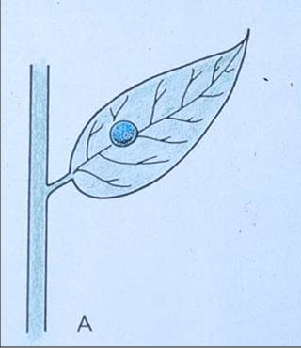
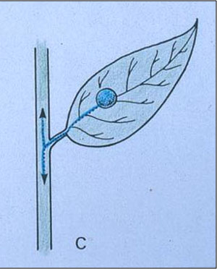
Mode of action is major factor
Contact
Systemic

Slide 10
Droplet size categories
Category | Symbol | Color Code | Dv0.5 (VMD)
Extremely Fine | XF | Purple | ≈50
Very Fine | VF | Red | <136
Fine | F | Orange | 136-177
Medium | M | Yellow | 177-218
Coarse | C | Blue | 218-349
Very Coarse | VC | Green | 349-428
Extremely Coarse | XC | White | 428-622
Ultra Coarse | UC | Black | >622

Slide 11
Comparison of micron sizes (Appox.)
2,000 | #2 Pencil
850 | Paper Clip
420 | Staple
300 | Toothbrush Bristle
150 | Sewing Thread
100 | Human Hair

Slide 12
droplet size reduction
Cutting droplet size in half results in 8x the number of droplets.
250
Microns
250
Microns
500
Microns
250
Microns
250
Microns
250
Microns
250
Microns
250
Microns
250
Microns

Slide 13
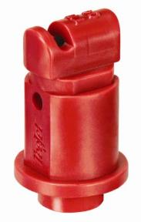
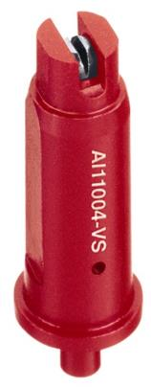
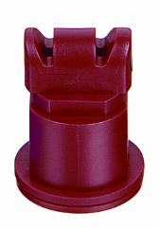
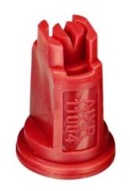
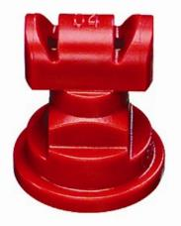
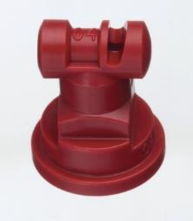
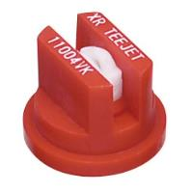
How do they all fit in?
<<Less Coarse - - - - - - - - - - - - - - - - - - - - - - - - - - - - - - -More Coarse>>
TTI
AITTJ
AI
AIXR
AI3070

Slide 14
Turbo teejet
Wide pressure range 15-90 psi
All-polymer construction
110 degree angle – 9 flow rates
Larger droplets for less drift
One of our most versatile tips
Fits standard flat spray/XR caps

Slide 15
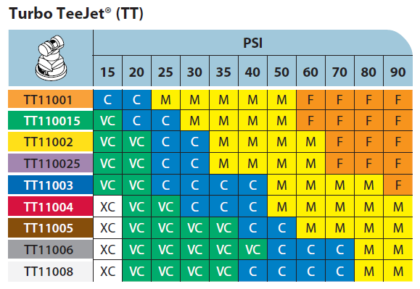
Turbo teejet

Slide 16
TT with three nozzles

Slide 17
TT with two nozzles

Slide 18
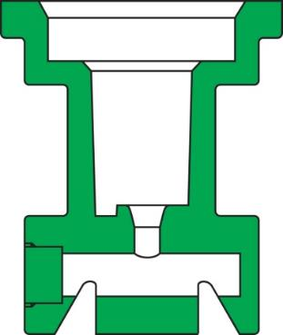
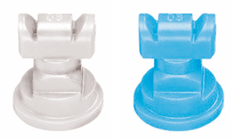
TTJ60 Turbo Twinjet
Rated for use from 20-90 psi
All-polymer construction
110 degree spray angle – 8* flow rate choices
TwinJet features plus improved drift control
Lower cost than stainless steel products
Droplets slightly larger than Turbo TeeJet of same capacity.
11008 & 11010 – will be released in 2015 Q1

Slide 19
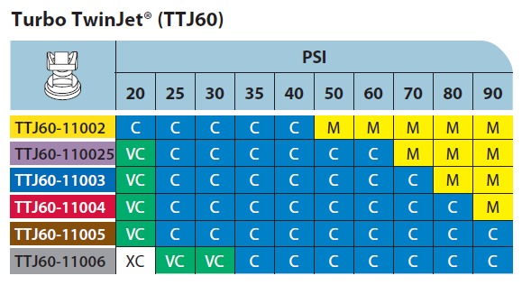
TTJ60 Turbo Twinjet

Slide 20
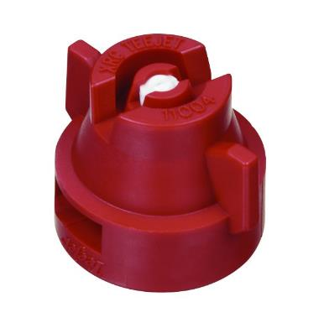
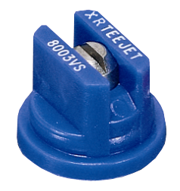
Xr/xrc TeeJet
Excellent distribution at pressures of 15-60 PSI
Choice of stainless, polymer, ceramic
80 and 110 degree in many flow rates
Available in combined tip/cap (XRC)

Slide 21
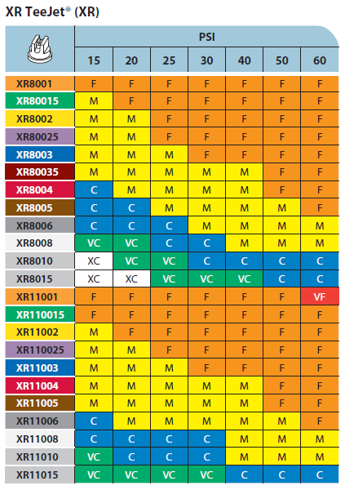
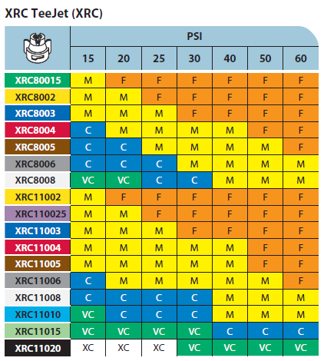
Xr/xrc TeeJet

Slide 22
Nozzle wear
When do I need to replace my tips?
Wear rates depend on:
Tip material (stainless, polymer, ceramic)
Chemicals used
Operating pressure
Care used when cleaning
Spray tips are considered excessively worn and should be replaced when the flow exceeds the flow of a new tip by 10% or has a disrupted pattern. If more than one tip is worn, replace the entire boom.

Slide 23
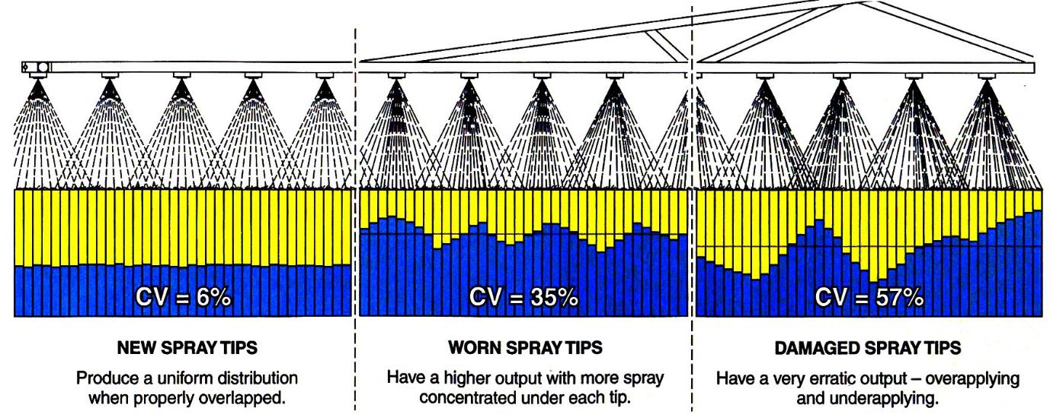
Nozzle ware
Damaged Nozzles
New Nozzles
Worn Nozzles

Slide 24
Formula
GPM = GPA X MPH X W
5940
GPM = Gallons per minute per nozzle
GPA = Gallons per acre (water)
MPH = Miles per hour
W = Nozzle spacing (in inches)

Slide 25
Formula Example with 30” Spacing
Parameters: Apply……….15 GPA
Travel……….6 MPH
Nozzles Used:
Nozzle spacing……..30 inches
GPM = 15 X 6 X 30 = 2700 = 0.45 GPM
5940 5940
Tip suggestion – TT11004-VP

Slide 26
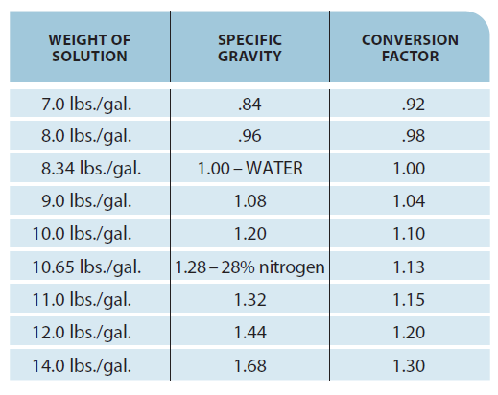
Specific gravity correction
Rate charts are based on water.
When spraying materials more or less dense than water, you must correct flow rates.

Slide 27
Teeject App – Apple and Android
Apple
Android

Slide 28
Greenleaf turbo drop
TurboDrop® Variable Rate Fertilizer Nozzle
Multi-purpose medium pressure air injection variable rate fertilizer nozzle, designed to provide a wider flow range for variable rate applications, wide speed changes and rate changes.
Operated from 20-140 PSI
Allowing 4x rate range at a given speed
Can maintain constant GPA rate over 4x speed change

Slide 29
How they work

Slide 30
360 Y-Drop nozzle selection
Spacing of Corn Rows
2
2
15 inch nozzle spacing (2 per 360 Y-DROP)
30” Row Corn

Slide 32
Questions

Slide 33
Nozzle material comparison
Material | Resistance Ratio
Brass | 1
Celcon Polymer | 2 to 6
Stainless Steel | 4 to 6
*UHMWPE | 8 to 10
Ceramic | 12 to 14
*Ultra High Molecular Weight Polyethylene

Slide 34
