Slide 1
Capture more yield potential

Slide 2
Potential within reach
Gregg Sauder and his team of farmers, agronomists and engineers have a mission:
for every farmer to reach the yield potential of modern seed corn.
As a farmer, Gregg has long focused on capturing more yield potential, and today, his
team at 360 Yield Center is putting the farmer at the center of it all. Taking a 360-degree view of key yield-limiting variables and how to course-correct for better results. In short, their goal is to give you the power to sense, decide and apply what you need for better-performing crops and better on-farm profits.

Slide 3
Push the boundaries.
Advancements in modern agriculture have broadened the potential for farmers:
Hybrid seeds reaching extraordinary genetic potential
Weed and pest protection elevated to maximum level
Equipment and planters engineered for superior accuracy and precision

Slide 4

GET MORE OF THE POTENTIAL YOU PLANTED

Slide 5



Get more of the potential you planted
360 SOILSCAN™ helps you sense the signals your farm is sending. It provides you with real-time nitrate and soil data — in the field. So
you have a more complete picture of what is affecting your crops.
360 COMMANDER™ provides you with the most comprehensive analysis of your farm, economic and weather data. Giving you insights and recommendations
for nitrogen application, planting rates and irrigation. To help you
decide what actions are necessary to improve your yield.
360 Y-DROP™ and 360 UNDERCOVER™ give you the ability to apply nitrogen,
pesticides, herbicides and more — to feed and protect your crops. When and where you need it.

Slide 6
OUR latest transformative farming solutions

Slide 7
Applying smart decisions just got easier

Slide 8

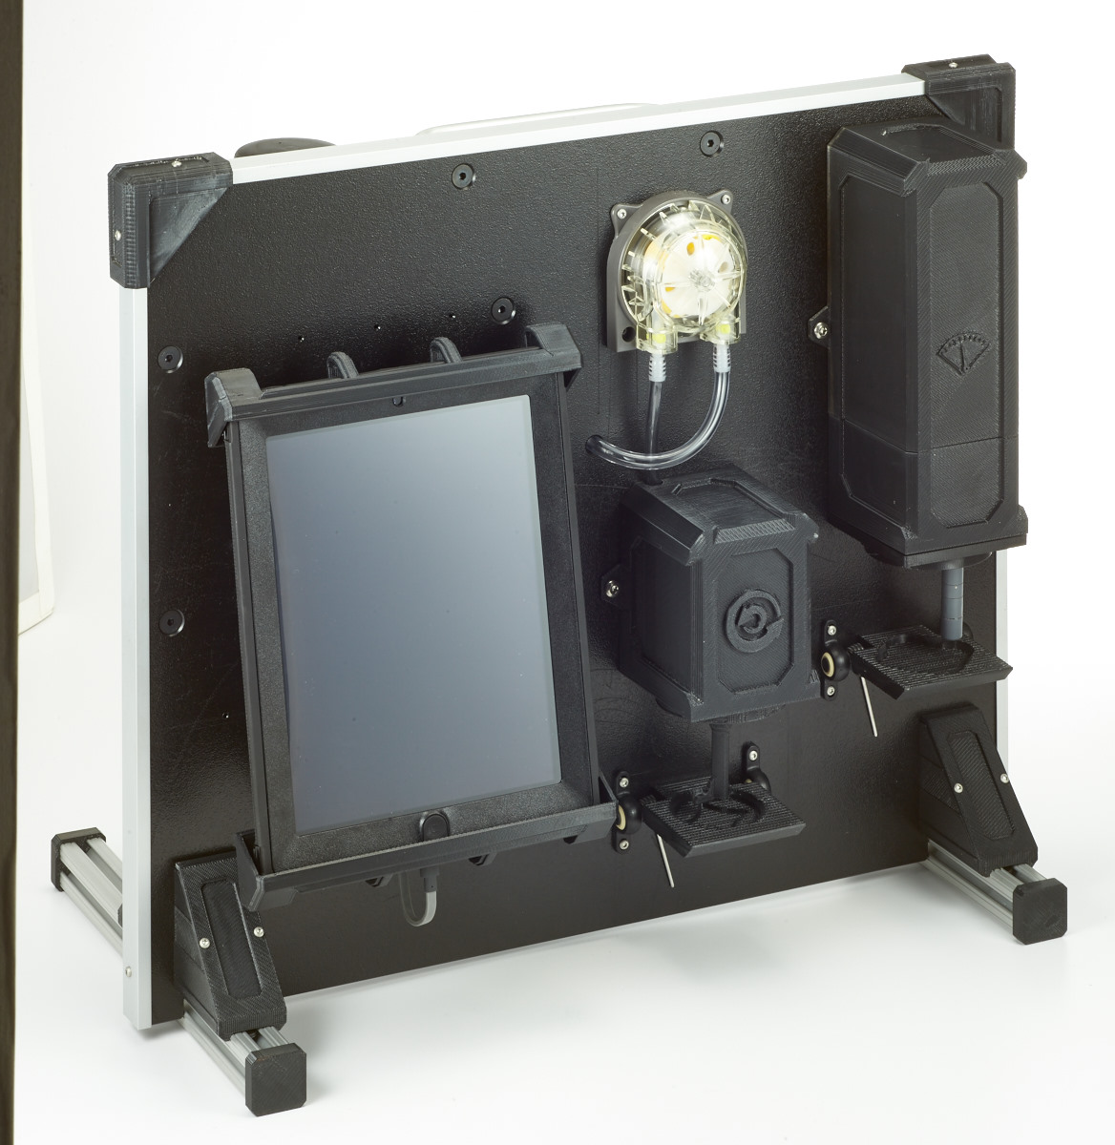
360 SOILSCAN™ is a portable soil testing tool that gives farmers the ability to perform soil nitrate analysis in about five minutes, so farmers can make more accurate and timely nutrient management decisions.

Slide 9
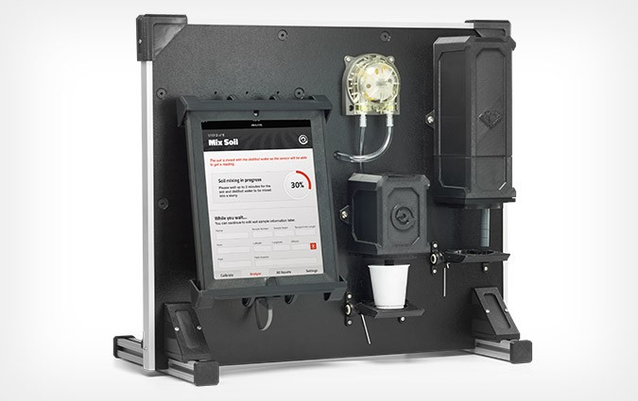
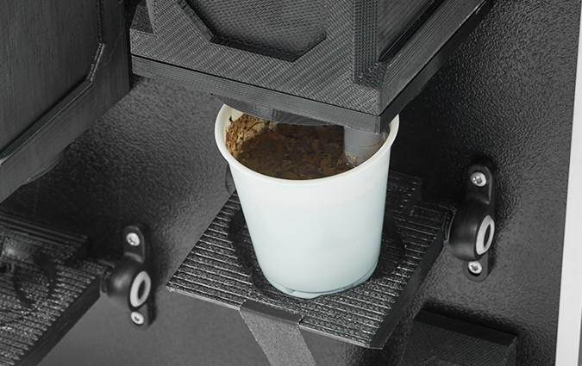
360 soilscan product updates
iPad interface walks users through the step-by-step, in-field soil testing system.
Multiple sensor slots to allow for future soil nutrient testing capabilities without the need for product upgrades.

Slide 10

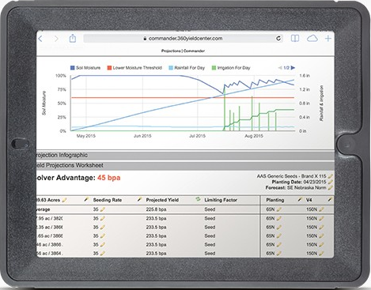

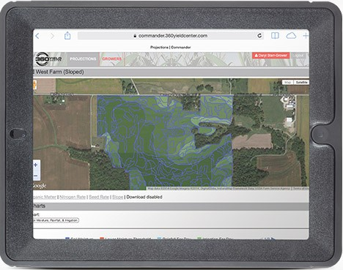
360 COMMANDER – a Web-based crop modeling tool – specifically gives you the insights you need to start reaching more of the potential you plant. It provides you with accurate, agronomic recommendations so you can make informed management decisions. It generates optimized, actionable seed, nitrogen and irrigation recommendations based on real-time information, and pulls in real-time data from outside sources and combines it with your data to create customized recommendations for your farm.

Slide 11
360 cOMMANDER Product updates
Rainfall Data
Track hourly, daily and seasonal rainfall. Yet, the user remains in control - you can make adjustments as needed.
Upload Field Boundaries in Bulk
Manage each unique field - and save processing time - by uploading field boundaries in bulk.
Upload Soil Sample Point Data
Upload raw point data with no need to set up or convert files.
Management Zone Upload
Upload previously developed management zones.
Nitrogen Chart
Monitor this limiting factor and gain real-time visibility with the nitrogen chart, which tracks available nitrates in your field.
Additional Users on Account
Manage your fields alongside your team by inviting your agronomist, and any additional users, to your account.

Slide 12

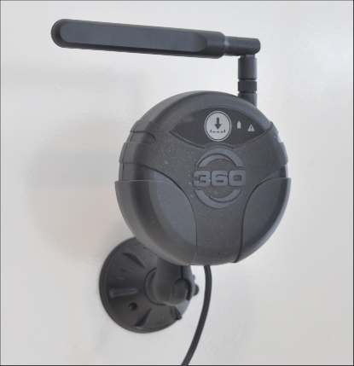
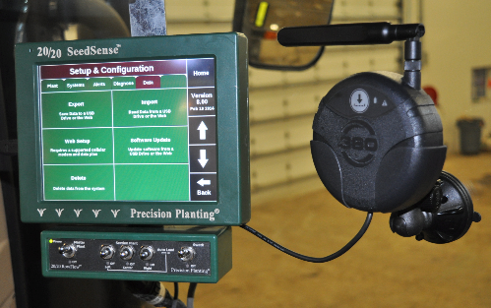
360 COMMANDER™ Bridge is a wireless USB system, powered by the nationwide Verizon Wireless® network, that allows farmers to download files from 360 COMMANDER directly to the monitor in the cab.
In the cab or anywhere, farmers will have more access to information and can, in real-time, take action on 360 COMMANDER prescriptions.

Slide 13
360 cOMMANDER IS Now Mobile
A new user-friendly mobile app for 360 COMMANDER also will be available in the app store for iPhone and iPad in the spring of 2015.
Now, farmers and agronomists can create crop management prescriptions with 360 COMMANDER from their office or home, pull the plan up from their tractor cab using the mobile app and make updates with real-time, in-field information.
With an up-to-the-minute plan, farmers can use 360 COMMANDER Bridge to send the real-time prescriptions to their tractor’s monitor without the need for USB drives.

Slide 14
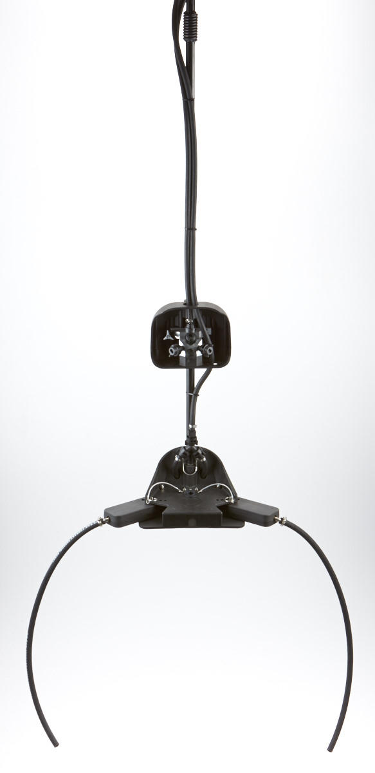
360 Y-DROP™ gives farmers a wider window of application and more control over when and where to apply nitrogen and other nutrients to their crops.
The unique design allows farmers to apply full-season nitrogen – even up to tassel – with precision placement and variable rate application.

Slide 15
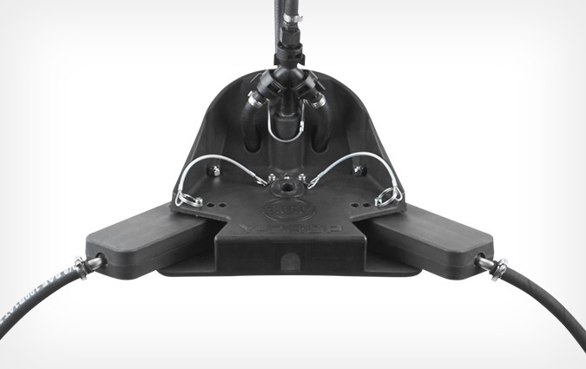
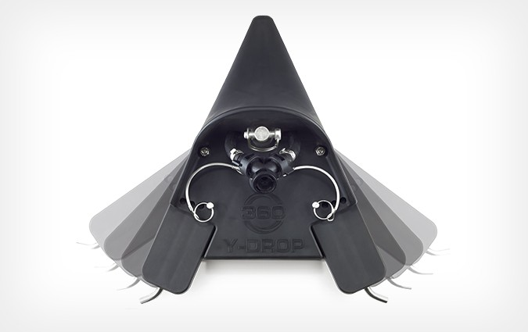
360 y-drop updates
Adjustable arms with quick release pins to allow for customizable hose placement for varied row spacing (20 inches to 30 inches) to ensure optimal placement of nitrogen and other nutrients at the stalk base.

Slide 16
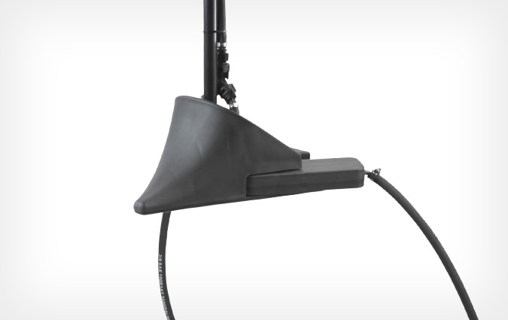
360 y-drop updates
A new shape to the nose of the 360 Y-DROP to ensure smooth gliding through the canopy to gently move corn leaves out of the way.

Slide 17
360 y-drop updates
A customizable spring damped riser to assist with centering the unit within the row for reliable nutrient placement.

Slide 18
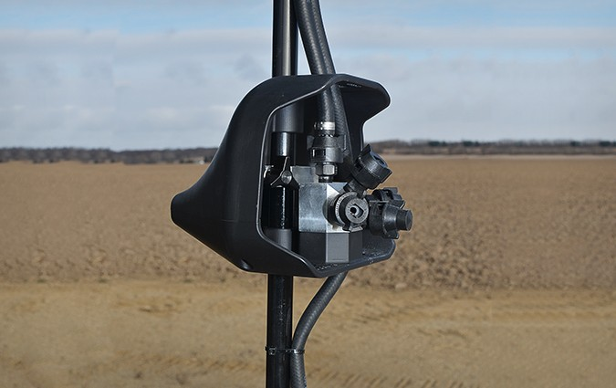
360 UNDERCOVER™ helps farmers protect crops from late-season disease and insect infestations.
It uses multidirectional spray nozzles and slides easily under the canopy so farmers can target fungicides, insecticides and nutrients exactly where needed for better product efficacy and improved crop health.

Slide 19
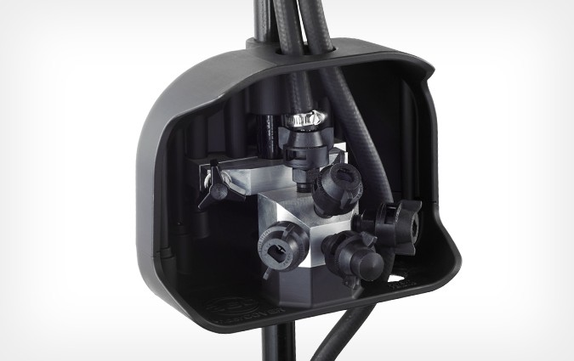
360 UNDERCOVER PRODUCT UPDATES
Customizable nozzle placement to allow for increased canopy coverage and adjustments for spray volume at the speed and pressure selected.

Slide 20
A New look at residue management

Slide 21

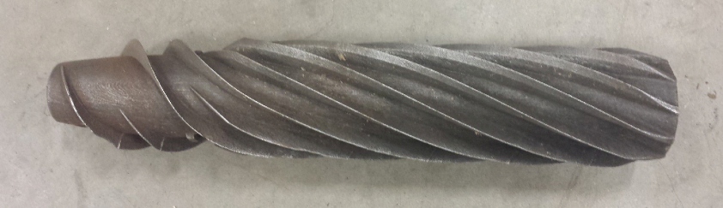
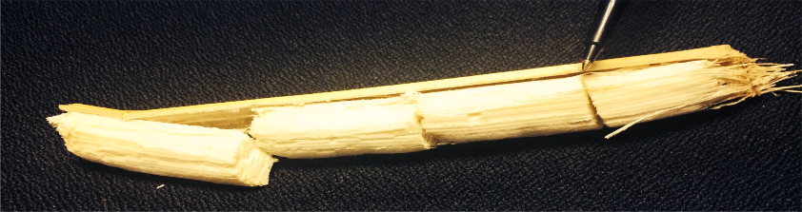
360 CHAINROLL™ is an advanced stalk roll system that offers a forward-thinking approach to residue management.
Chops and crimps stalks but leaves most sections connected
Makes residue more available for microbial breakdown, increasing decomposition rate
Leaves fewer small-residue pieces in the seed zone to help decrease likelihood of seeding blight and poor emergence
Available for field testing in fall 2015

Slide 22
360 CHAINroll™ in action

Slide 23
New LOOK at residue management
Yield potential starts with the previous year’s harvest and how crop residue and soil health is managed.
Residue management is a key part of the 360 Yield Circle™.
360 CHAINROLL offers a new approach to help farmers think differently about corn stalk chopping.

Slide 24
Thank you

